Slide 1
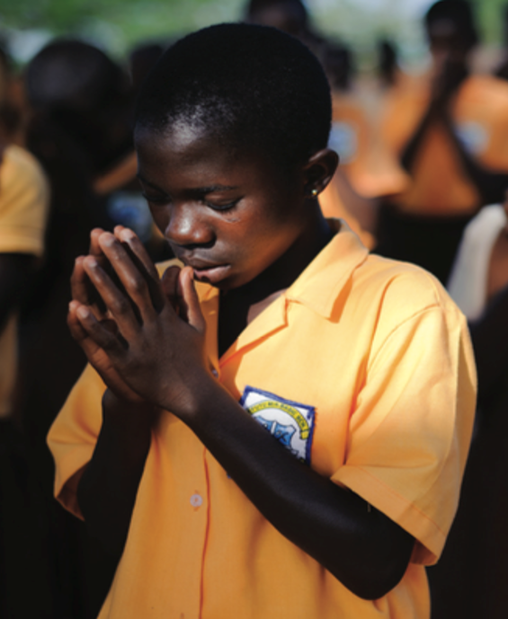
FPCC Regional
Faith
Engagement
Forum
for South Aisa
8th to 10th May, 2022

Slide 2
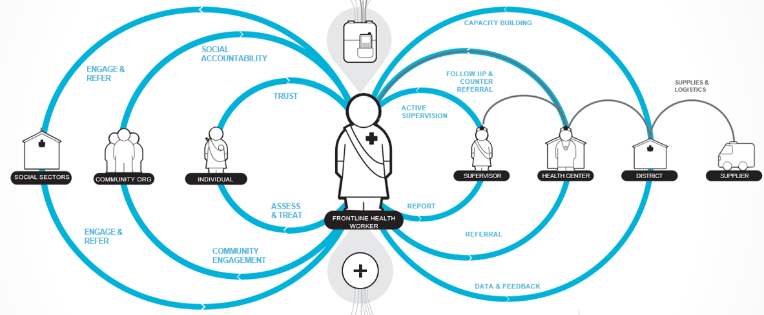
Central SBC Role in Community System Strengthening
Establishing Community Partnerships
at Scale to Deliver Results for Children

Slide 3
2014: A Global Mapping - UNICEF engagement with religious communities which highlighted the need for more strategic and systematic partnership with Faith
Most common focus 75% SBC-related
Common Characteristics:
Single Faith
Single Sector
Ad Hoc / Short term
Message-Based Instrumentalist
2018 Mapping - Less than half of partnerships formalized through Cooperation Agreements

Slide 4
Partnership on Faith & Positive Change for Children, Families & Communities
Largest inter-faith network of religious leaders & congregations
Inter-connected Inter-Faith structures at Global, Regional and CO level
Religious leaders
Women-of-Faith
Inter-Faith Youth Councils
Lead development
agency on SBCC Practice
with 450 C4D staff in field
Tech knowledge on children
Liason between Govt & CSOs
High level advocacy on child
rights issues
Knowledge leadership on Evidence on Faith & Dev.
Convenors of Int’l Faith-Based NGO Partners
Child & Family Wellbeing

Slide 5
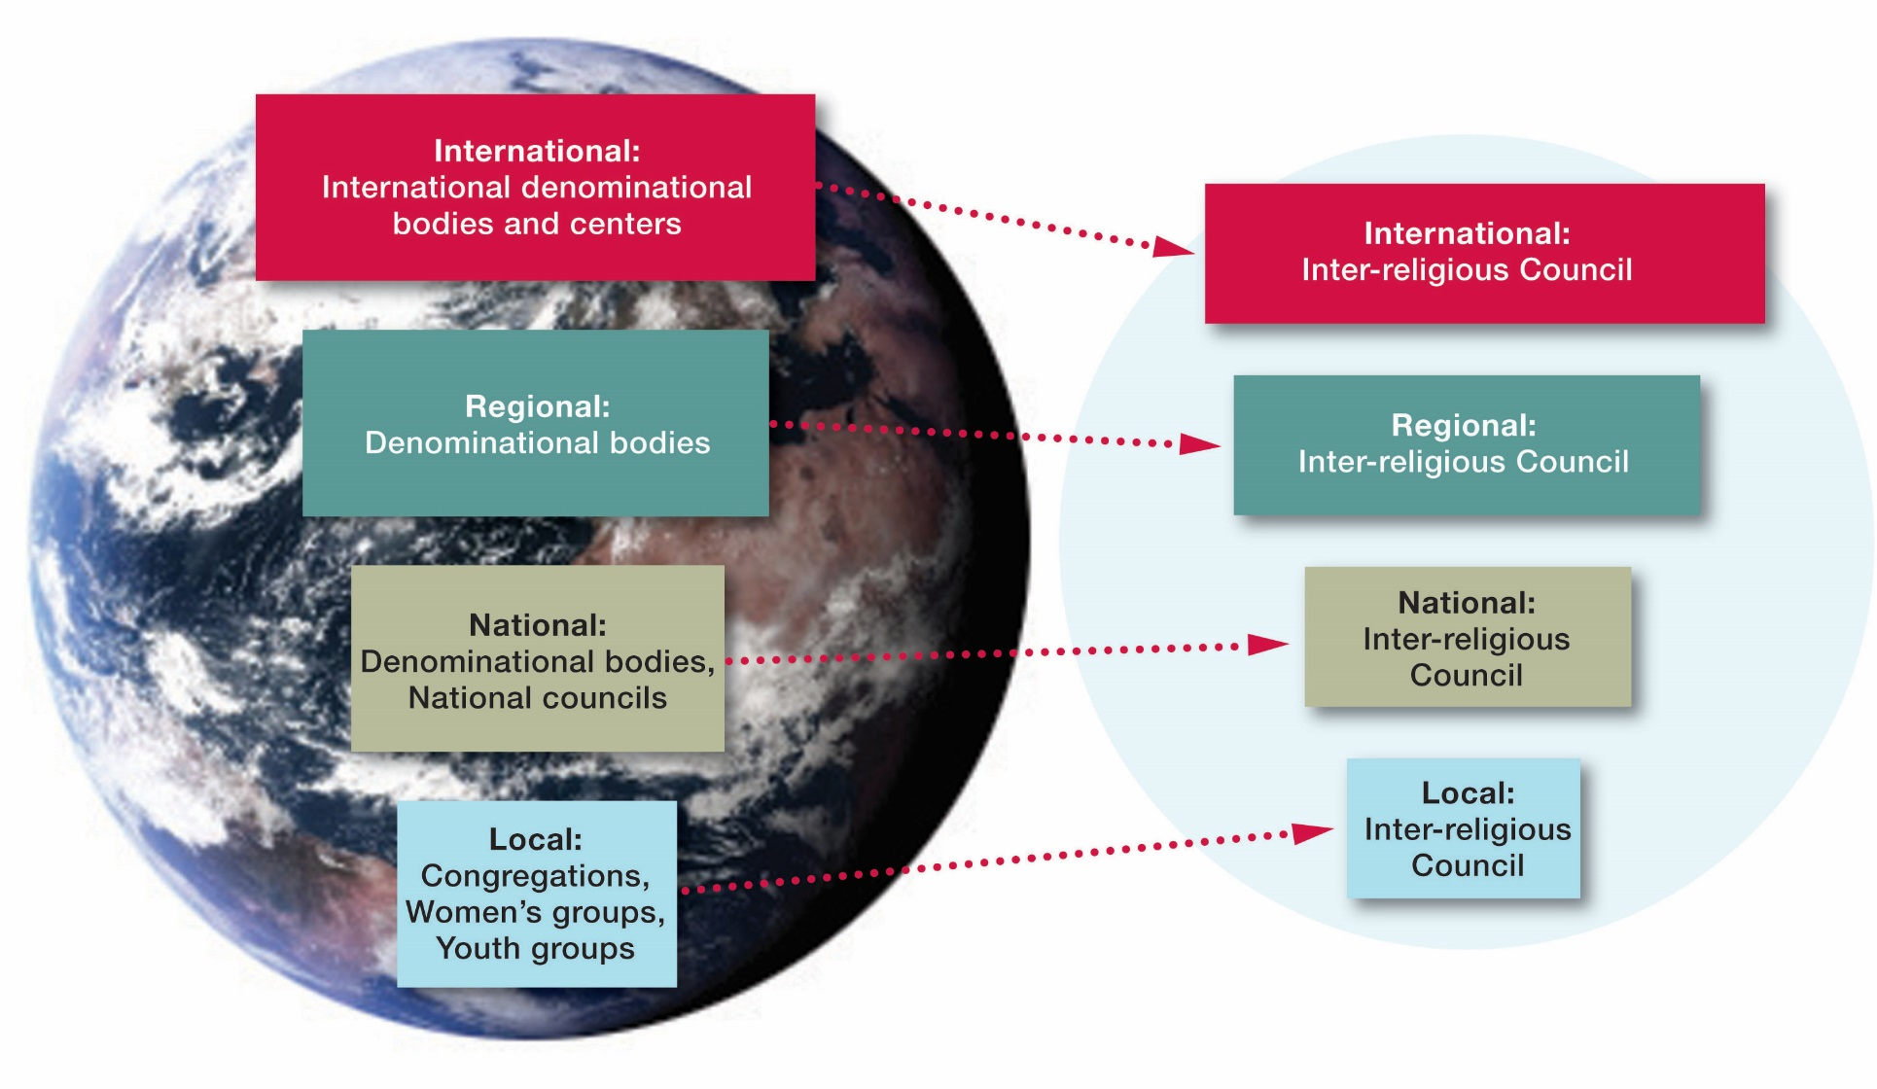
Religions for Peace Structure

Slide 8
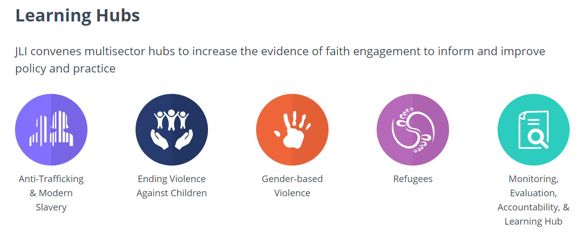

Slide 9
FPCC Advisory Group of International FBOs
(not all agencies in the group are visually represented)

Slide 10
Evidence Based Foundation
Global
Literature/
Evidence Review
2018
17 Country Office Case Studies
2014 and 2018 Mappings
Review of over 40 FBO Toolkits/ Guidance Review

Slide 11
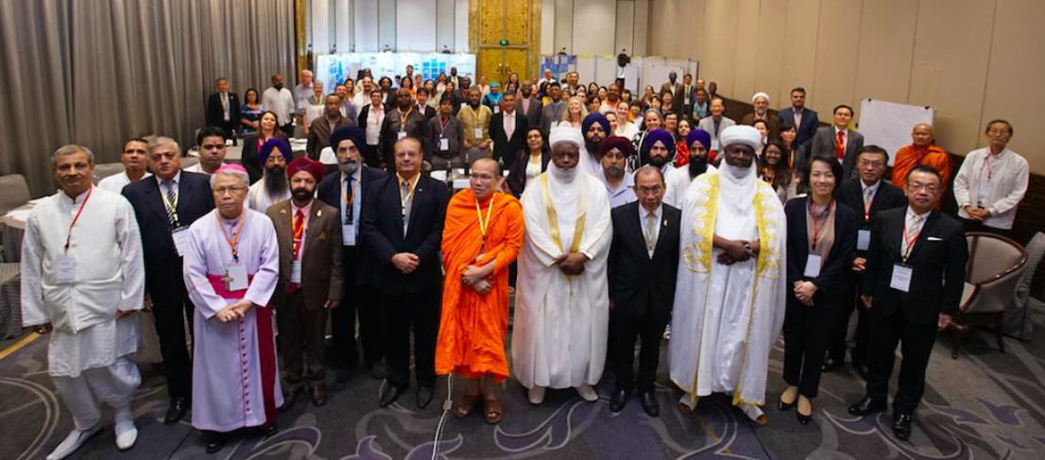
UNICEF Global Consultative Workshop on Faith for SBCC Initiative
Bangkok, Thailand July, 2018

Slide 12
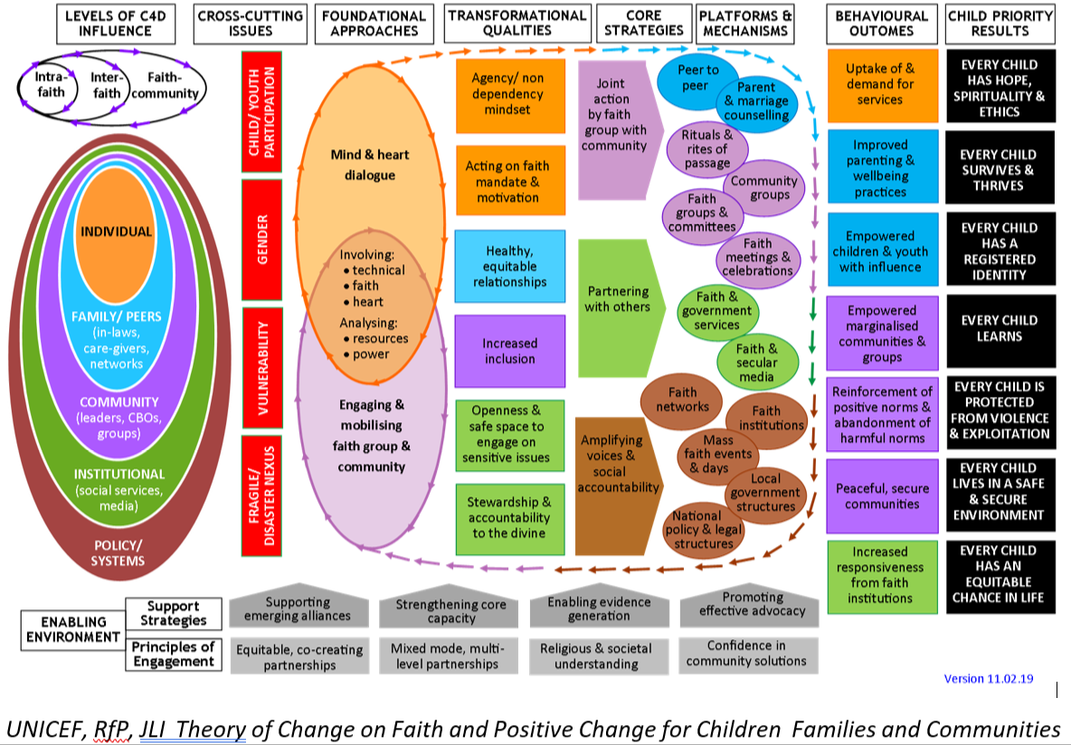
UNICEF, RFP, JLI Theory of Change on Faith & Positive Change for Children, Families and Communities

Slide 13
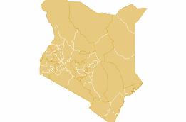
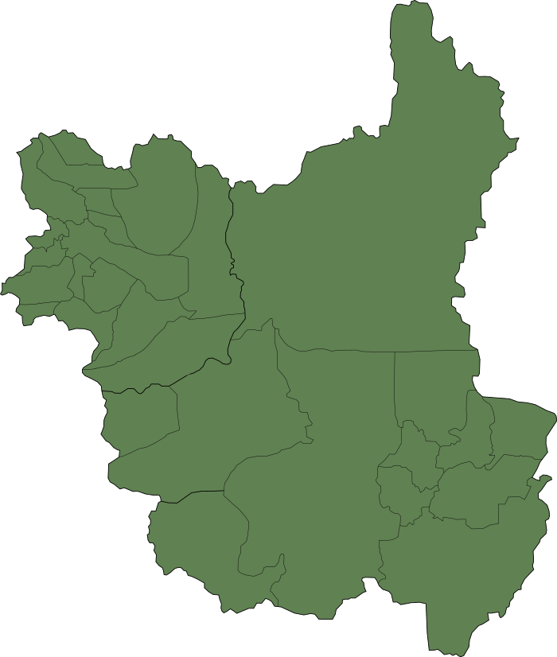
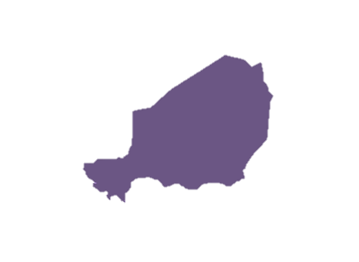
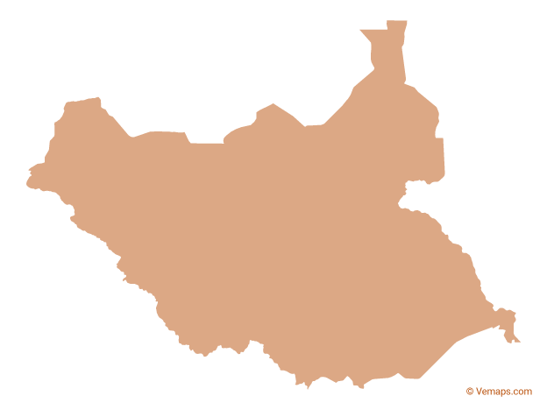
Work Rocks in 6 Focal Countries
Malawi
Faith & Positive Change
for Children
Early Adopter Countries
South Sudan
Kenya
Liberia
Niger
Cameron

Slide 17
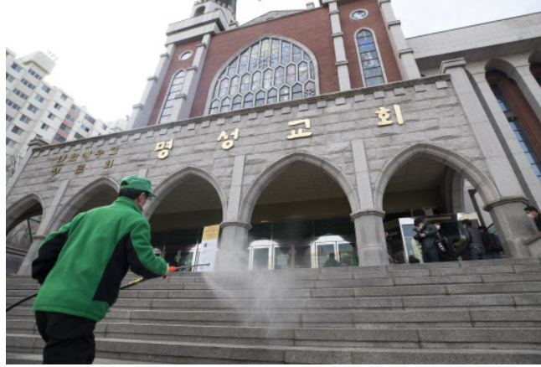
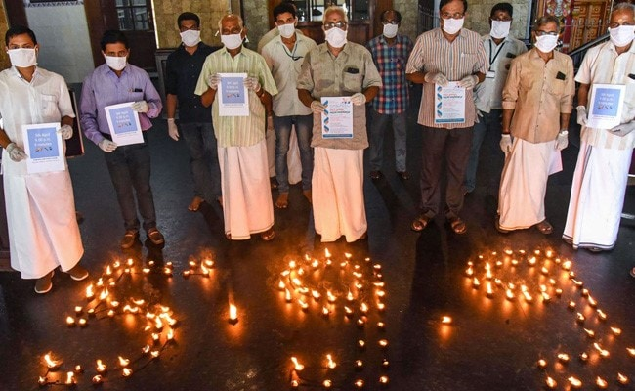
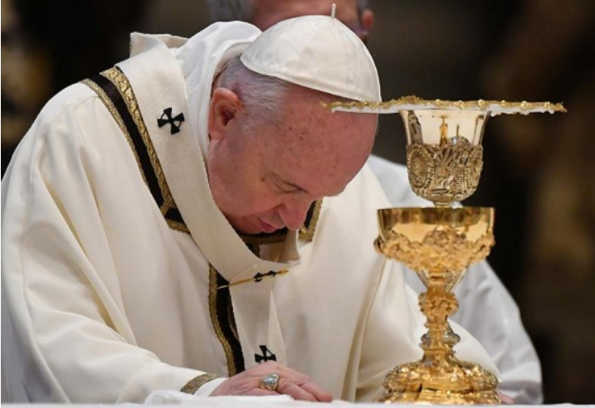
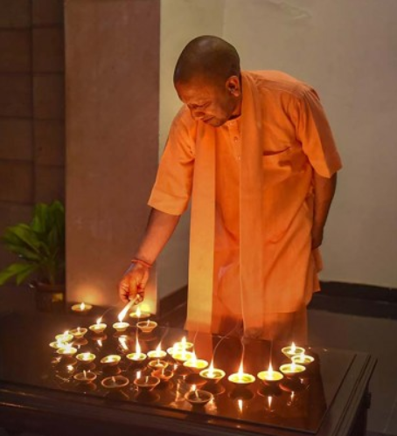
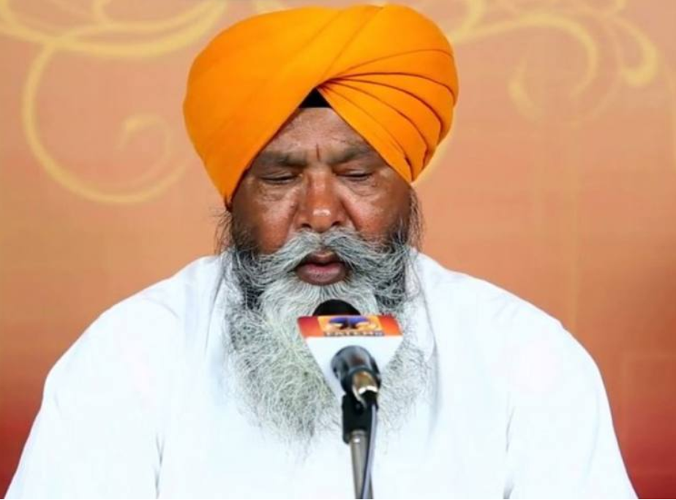
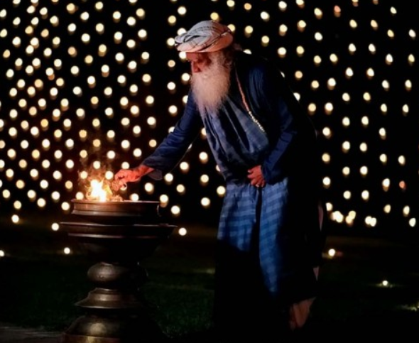
Key Objectives of the Campaign
Manage communication, misinformation and rumours
Dispel fear, stigma, discrimination, reduce tensions and promote social harmony
Promote adaptation of religious gatherings, practices rituals, handwashing & hygiene
Address specific needs of vulnerable groups
Prevent violence against children/youth and their active engagement in the initiative
© UNICEF/UN0306241
Promote and support the recovery of social services, resilience and return to normalcy

Slide 18
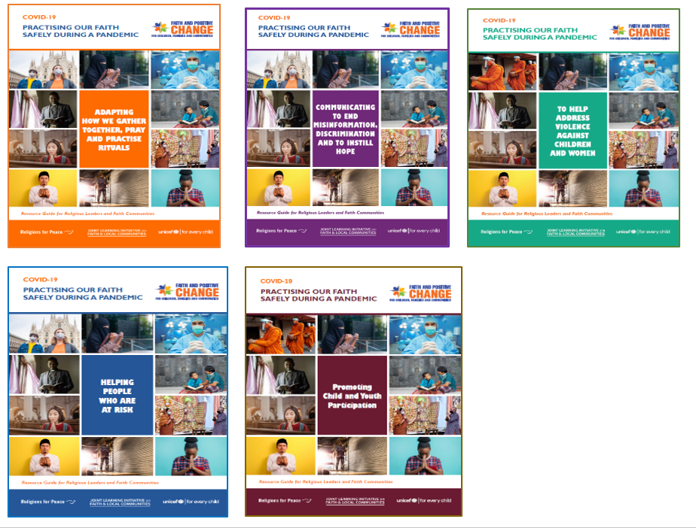
Global Thematic COVID-19 Guides
In support of
Faith in Action
Pandemic Response

Slide 19
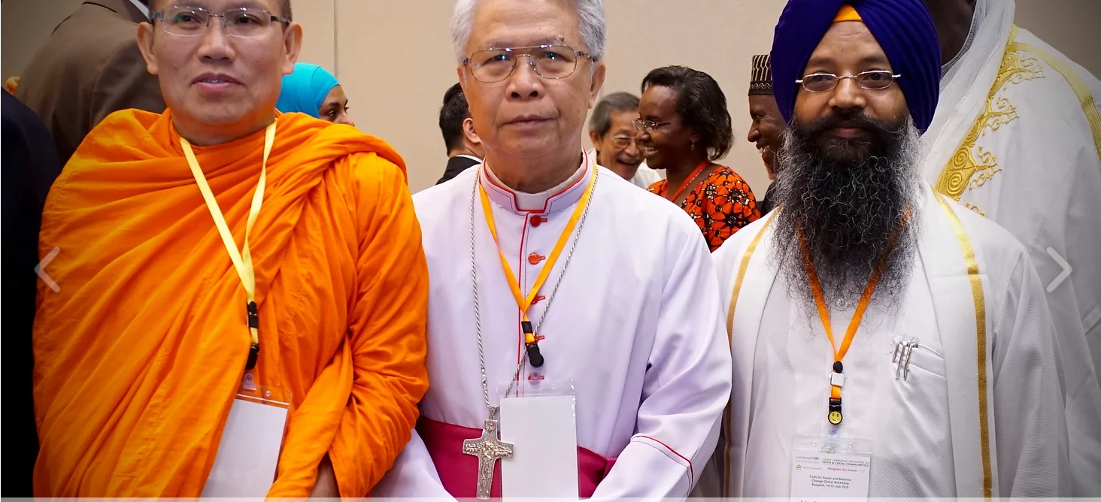
FPCC WEB PLATFORM
https://www.faith4positivechange.org/

Slide 20
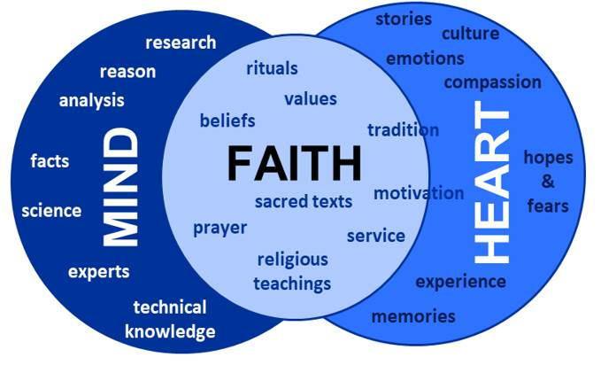
IN-DEPTH MIND-HEART DIALOGUE WEBINARS -
Example of mapping exercise with Faith leaders to identify where COVID-19 rumors and misinformation spread in their communities

Slide 21
Core Resources for FPCC Global Scale Up and Roll-Out

Slide 22
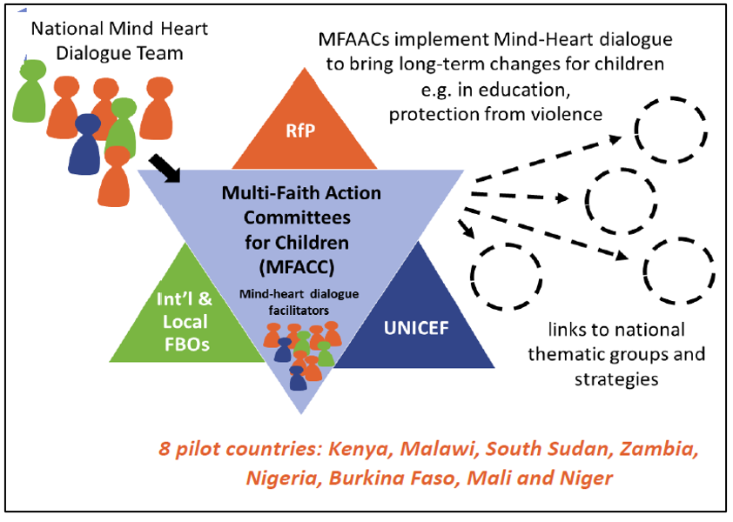
FPCC Training Model

Slide 23
Faith & Positive Change for Children, Families & Communities (FPCC) Inter-Faith Coordination Mechanisms
.
RfP
Regional
& National
Inter-Religious Councils
RFP
Global
and
Regional
Tripartite
Coordination Groups
Multi-Faith Coordinating Committees for Children, Families & Communities (MFAC)
Humanitarian Action & Community Engagement
Child Friendly Cities
Committees
Violence Against Children Committees VAC, CM, FGM
Joint development & monitoring of inter-Faith plans of action on agreed priorities
Incorporation in UNICEF Annual Workplans and Budgets
National Coordinating Committees for Children, Families & Communities
HIV/AIDs Committees
Early Childhood & Education Committees
Incorporation of plans of other FBOs and other development partners
JLI / FBOs
UNICEF
Int’l & Local
FBOs
UNICEF Regional,
Country &
Sub-national Offices
Child Health Mental Health and Nutrition Committees
Reporting & representation on National Coordination Groups

Slide 24
Priorities for 2022
Partnership Review of Reconstituted Global FPCC Advisory Group: UNICEF-JLI-RFP
Further deepening and scaling-up of FPCC across regions with formal partnership agreements.
FPCC hosting of Regional webinars with use of the new FPCC training video
Establishment of Country Level MFACCs with development of RfP-UNICEF Inter-Faith plans linked to UNICEF Annual Work Plans and Risk Communication and Community Engagement/COVID plans.
Further development and roll out of Training of Trainers package for “Faith, Heart and Mind” Dialogue.
Monitoring and reporting system linked to increase accountability
Resource Mobilization.

Slide 25
Future Priority: FPCC linkages with other Global Faith Engagement initiatives
Other UN initiatives
UN Task Force on Religion and Development
UNOHR – Faith for Rights
UNFPA – Global progs FGM/CM
UNHCR (Migrants & Ref)
WHO EPI_WIN COVID
UNEP – Faith & Environ
Others ?
World Bank
Faith Evidence Research Group
FPCC HQ, RO, COs
UNICEF
RfP
JLI
University Initiatives
Leed University – Faith Actors KAP on COVID
Berkely – Exploring Faith Dimension for COVID
USAID
Faith Evidence Summit
John Hopkins U.
CDC
Violence Against Children
Parenting for Lifelong Health

