Slide 1
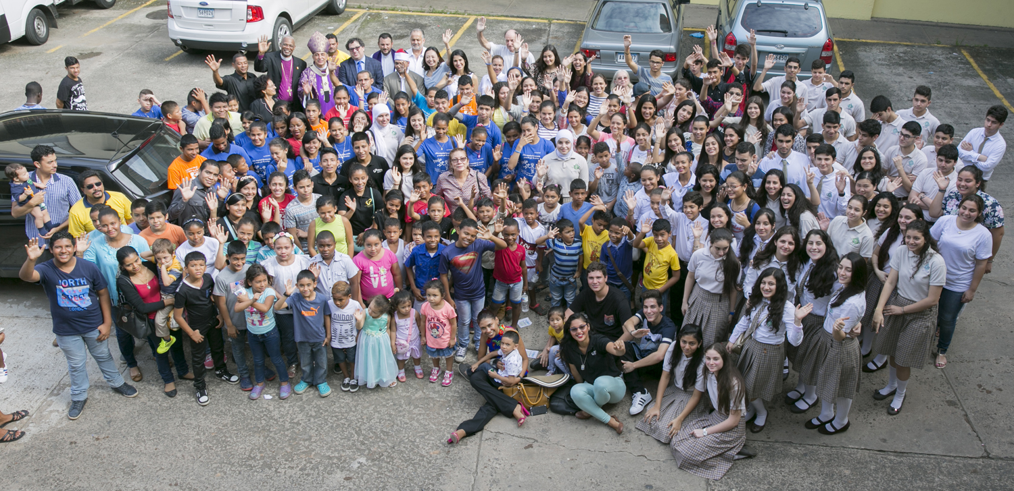
Panama
Social & Behaviour Change Initiatives
Country Delegation:
Kyungsun Kim – UNICEF Panama Representative
Isis Navarro – Secretary General, Ecumenical Committee of Panama (COEPA)
Lizia Lu – UNICEF Panama communications specialist

Slide 2
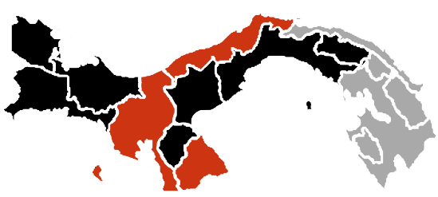
Country Background
Demographic Information
Major Issues Facing Country / Children
Panama is a multi ethnic country:
9.2% afro descendants, 12.3% indigenous population,
78% distributed: mestizo, Caucasians, Asians, and others.
45% of children between 1 and 14 years of age are suffering violent discipline.
In 2017, the reported cases of sexual abuse in children increased 12.2% over 2016
In 2015, out of the 3,412 victims of crimes against sexual integrity, 88% were children under 17 years of age
4.2 million (estimate total) - 51% male, 49% female.
1.3 million children.
28% of the population lives in the capital city.
Panama
Located in Central America, borders with Colombia and Costa Rica
Upper Middle-Income Country (services based economy) with a GNI per capita at $ 12,140 (2016)
15th highest in the world in terms of inequality.
Key Behavioral and Socio-Cultural Issues
Existing Research
MICS 2013 revealed that 45% of children between 1 and 14 years of age in Panama have received violent discipline, this means, 1 in 2 children´s are growing been exposed to violence in their family environment.
Normalization of violence
Parents regard their children as being their ‘property’, therefore they are entitled to decide what is best for them, and not recognizing them as subject of rights; this includes practicing violent discipline.
SITAN VAC (2017) reflects that domestic violence and child abuse as priority concern on adolescents and families.
A survey conducted in Panama by UNICEF in 2014 (La Voz de los Adolescentes) indicated that children have more trust in religious leaders than local authorities such as police, politicians, etc..

Slide 3
Religious Context
Panama is a diverse country
Christianity (Roman Catholic and Protestant)
Judaism
Islam
Buddhism
Baha’i
Hinduism
Other Christian denominations: Later Day Saints, 7th day Adventists
Historical presence of different religions for over 100 years
Panama’s (historic) cultural diversity has been instrumental in the interreligious collaboration.
Christianity is the most widely spread
Roman Catholic church the widest presence; WYD 2019 will take place in Panama. However, Evangelic churches (mostly Pentecostal) are gaining high relevance, especially in impoverished or highly violent communities.
Key religious institutions
Ecumenical Committee of Panama (COEPA)is the only one in Latin America with presence of roman catholic church.
COEPA’s work started during the final days of the military dictatorship in Panama, acting as mediator and peacebuilder, to face the violent situation taking place in the country. Currently, COEPA is actively considered by the government to guarantee the transparency and the ethics in the processes related to people (children and adults; this includes interreligious dialogue. Therefore the creation of the Interreligious Committee of Panama, which is established within the structure of the COEPA, and groups leaders of Judaism, Islam, Baha'i, and Christianity in Panama.

Slide 4
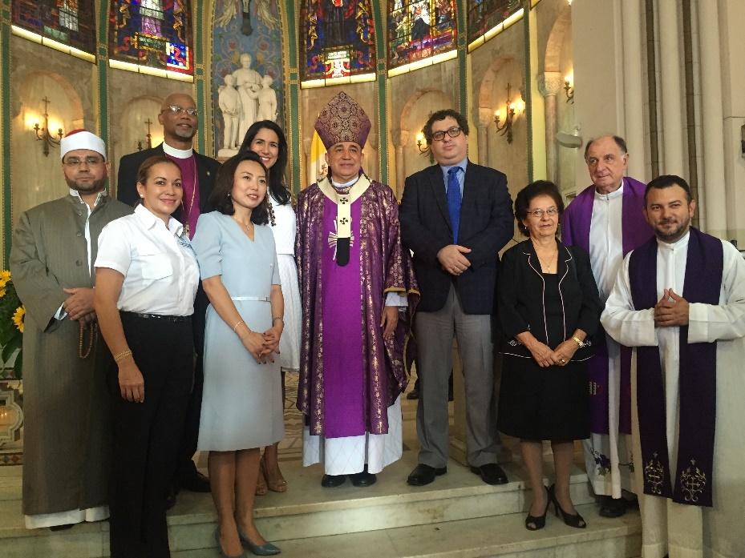
Religious Context
Existing Modality of Engagement between UNICEF Panama and Ecumenical and Interreligious Committee of Panama (COEPA)
Collaboration between COEPA and UNICEF Panama began in 2011, when UNICEF was invited to take part of the first celebration of the Day of Prayer and Action to End Violence Against Children (DPAC).
This was the starting point for ongoing work between both organizations, including components of public advocacy, adolescent participation & training, media engagement, and interreligious presentations.
Religious leaders in Panama have a high level of trust and credibility, and with the know how of UNICEF, it is a good way to join forces to continue advocating for the end violence against children.
Religious leaders from the Ecumenical and Interreligious committee of Panama during the closing event of DPAC 2016

Slide 5
Key Components of Engagement With Faith Actors on SBCC
Religious leaders understand their role on advocating on violence against children, not only within their community, but also in the media
Religious leaders encourage children to participate and have a voice in topics that are related to them
Parents, caregivers, teachers, local media, relevant government institutions
Parents, caregivers, teachers, local media, relevant government institutions
Components
Main Participants/Target Groups

Slide 6
Key Expected Outcomes of Faith for SBCC Initiatives
Outcome 1
Advocacy on EVAC
Religious leaders of the FBO from COEPA become champions advocating for positive parenting and ending violence against children
Outcome 2
Empowered children
Children from different FBO become advocates on children's rights

Slide 7
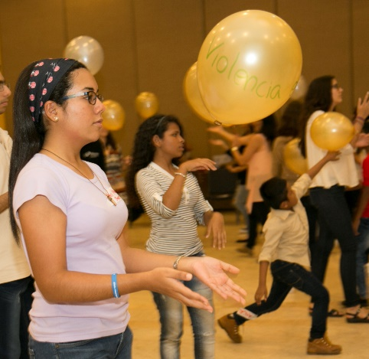
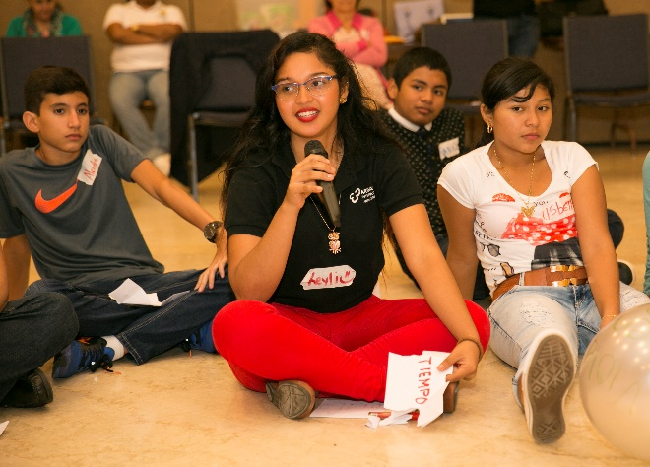
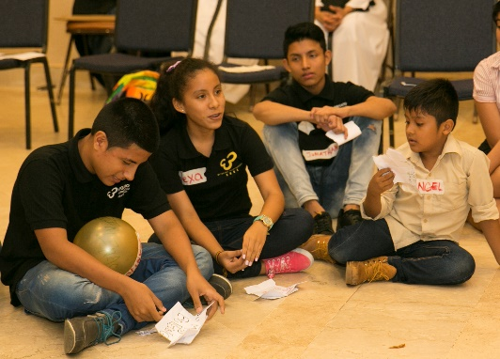
Implementation Strategies/ Faith-Based Mechanisms / Materials
Youth assembly
COEPA and UNICEF established the youth assembly to provide a space where children participation is fomented, It also allowed children to express proposals on how work with children should take place
Children from the different FBO would be trained on the importance of their participation, using the Learning to Live Together methodology from Arigatou GNRC (co created with Unicef), which contemplates topics such as leadership, collaboration, values such as respect, empathy, responsibility and others.
The assembly meets periodically to renew their commitments to continue working to end violence against children, and the children who are members of this group are then the spokesperson during the DPAC campaign.

Slide 8
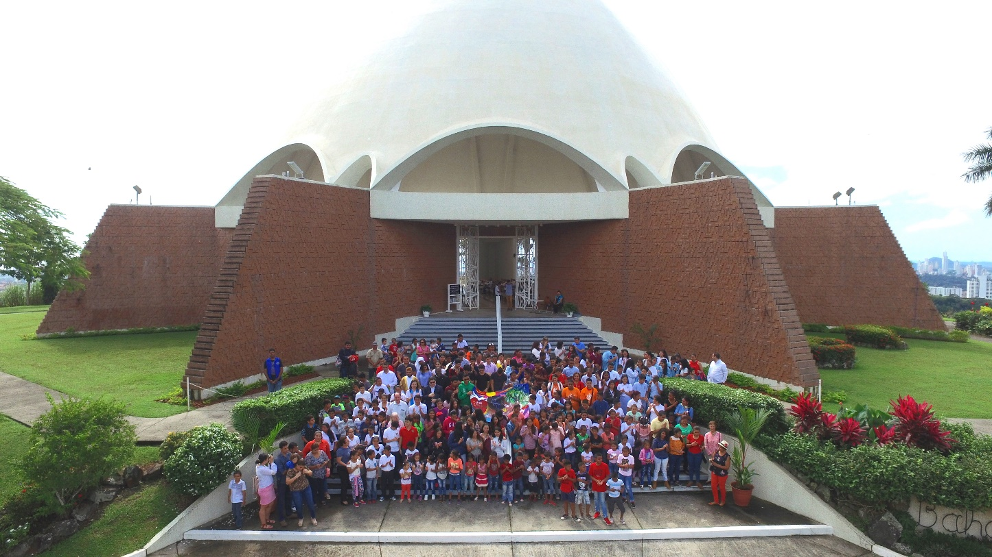
Implementation Strategies/ Faith-Based Mechanisms / Materials
Day of Prayer and Action for Children (DPAC) – FBO leaders as advocates
During the month of the celebration of Day of Prayer and Action for Children (DPAC – Nov. 20th), all leaders of the different FBO participating in COEPA will include a message on EVAC and DPAC during their religious services.
The closing of the campaign (which has a duration of a month) includes two key events: one is a catholic mass (which is televised nationwide) chaired by the archbishop of Panama and has the participation of the leaders of the different FBO; the other event is an interreligious event where children and leaders gather together to offer a prayer according to their tradition, for peace and ending violence.

Slide 9
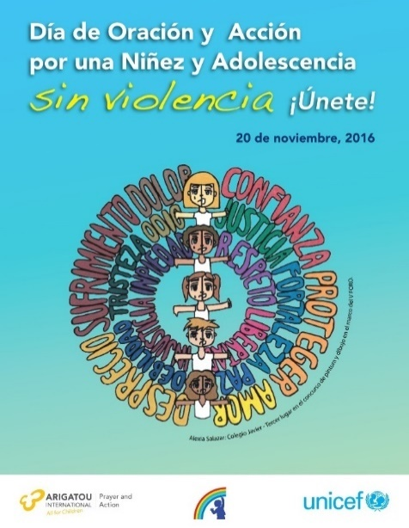
Implementation Strategies/ Faith-Based Mechanisms / Materials
Media – FBO leaders and children advocate on EVAC
Every year, UNICEF collaborates with COEPA on the campaign Day of Prayer and Action for Children (DPAC), to advocate on ending violence against children. The campaign includes a series of media activities:
Children and religious leaders as spokesperson on EVAC media tour; including spaces on prime-time TV, radio, and print media
A public statement signed by the senior leaders of the FBO in all print media in Panama advocating on EVAC
UNICEF provides technical information including data on children, through its staff for training on children's rights
Examples of the DPAC campaign materials

Slide 10
Multi-Media Components / Plans to Engage Through Media
Media Context
Radio is the media with the widest penetration, as it is available nationwide
Four main open TV channels with national coverage
Internet penetration in Panama is 57%, the 10th in Latin America
6.9M active mobile phone lines in the country; 145% higher than the Panama population
Continue with media alliances to support during DPAC campaign
Evaluate the introduction of social media platforms (challenge: to have a permanent community manager)
Identify other moments during the year to continue advocacy on EVAC in local media; introduce the topic of positive parenting

Slide 11
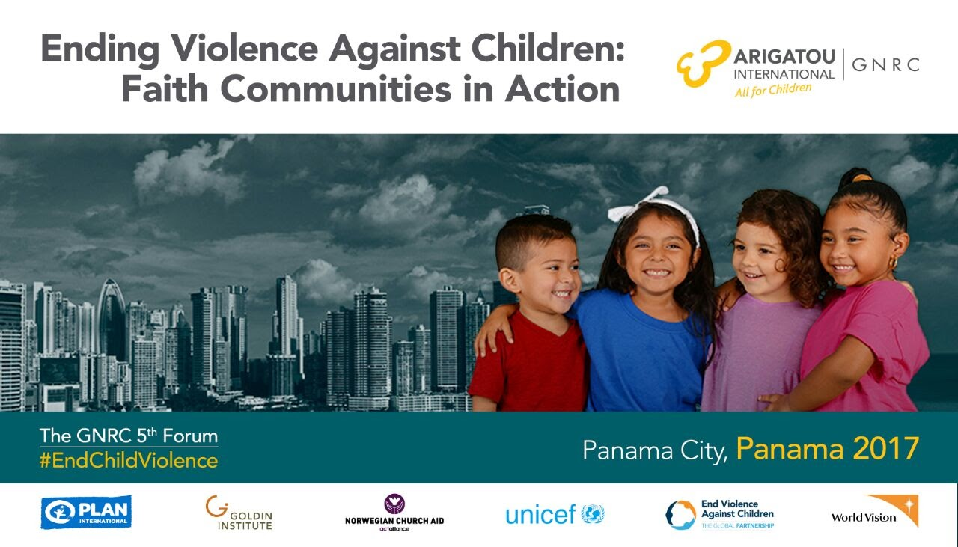
Implementation Strategies/ Faith-Based Mechanisms / Materials
Global focus
COEPA is the Panamanian Chapter of the Global Network of Religions for Children (GNRC), from Arigatou International.
In 2015, GNRC recognized the collaboration between COEPA and UNICEF as a best practice in terms of interfaith initiatives to end violence against children, and since then, GNRC has been partner for the annual celebration of DPAC.
The best practice in Panama was a decisive element for GNRC to host its 5th GNRC Forum in Panama: 30 Panamanian children from different FBO’s advocated to end violence against children in this international forum

Slide 12
Estimated Expenditure and Funding Sources for 2018
Estimate Expenditure in US 000’s
Funding Sources: Regular resources

Slide 13
Main Achievements / Results
Religious leaders recognize Unicef as a key partner in the work on ending violence against children
Children empowered on knowledge about their rights and ending violence
A new generation of youth leaders that are working with religious leaders to empower other children

Slide 14
Main Challenges
Type | Issue | Attempts to Address
Other | Sistematization of the best practice | Hiring a consultancy
 | A more active engagement from religious leaders in the advocacy process | Leaders will speak more actively for the approval and the implementation of an Integrated Child Protection System
 | Measuring impact/results | Establishing indicators
Logistical | Scaling it up | Identifying other leaders and communities to replicate this model

Slide 15
Key Lessons Learned
The Youth Assembly was key for building leadership capabilities in children. Involvement of parents is also instrumental.
UNICEF Panama has developed a successful work dynamic with leaders of different faith communities, expanding its partner’s network to promote the importance of protecting children’s rights
UNICEF technical assistance has strengthened this initiative in Panama creating culture for adolescent participation. There is an ongoing feedback process that allows to identify ways in which the work of the network can scale up and have impact level results.

Slide 16
FUTURE PLANS
for Expanding Strengthening, Scaling-Up or Sustaining Engagement
on Faith for Social and Behaviour Change
Complete documentation of the collaboration with COEPA
Establishing a system of monitoring and evaluation of the impact (results indicators)
Possible expansion of the youth assembly to other regions in Panama
Introduction of positive parenting tool

