Slide 1
FPCC Mind Heart Dialogue
Reflective and experiential learning process
More meaningful way to approach faith engagement to catalyze meaningful social and behavioral change.
Pierces beneath the surface to expose genuine doubts, tensions and motivations.
Equips us to respond effectively to gaps we have identified or issues our faith groups and organizations need to address within a safe and shared space of influence.

Slide 2
MIND | FAITH | HEART
Draws on technical knowledge Emphasis on Tools, processes Evidence of what works, why and with whom Shows/demonstrates/proves benefits of adapting existing positive practices or abandoning harmful ones. | Explores spiritual beliefs, values, and motivations (whether linked to a particular religion or not. Creates space to positively reflect on and interpret faith teachings and practices Integrates prayer/ meditation into processes of change. | Reflects on experiences and emotions to unpack drivers of behaviors Develops empathy and personal motivation for change. Analyses culture and power: identifies norms that underlie unequal opportunities Releases local skills and resources for practical action.

Slide 3
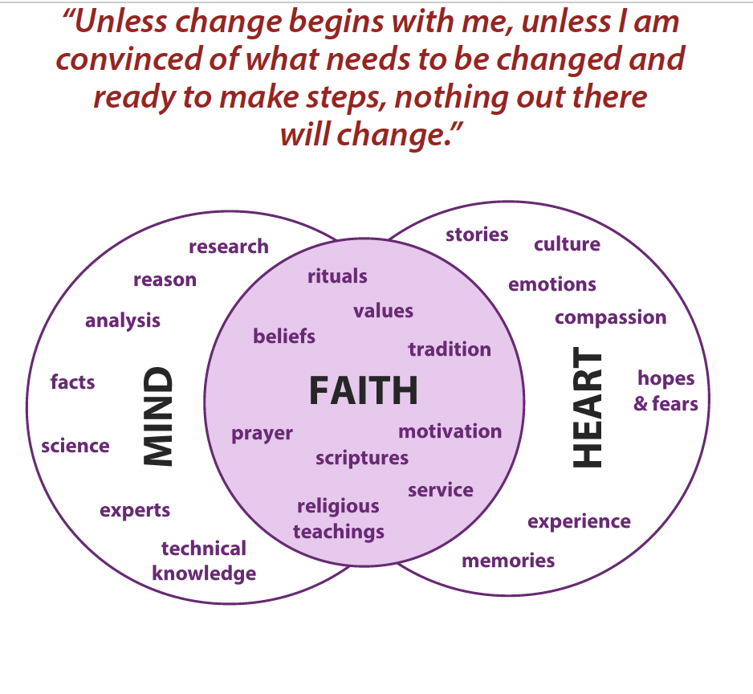
Mind Heart Dialogue Facilitation (from Facilitation Guide)

Slide 4
Lessons Learned and Challenges from ESAR/WCAR
Need to align MF FACILITATION Training with launch of MFAACS
One round of training in facilitation skills is not enough to master capacity to link MHD with measurable behavioral outcomes.
For sustainability, need to invest in established regional training entity → Build regional capacity → provide support/mentoring to national training teams → MEAL on MH Dialogue capacity
Need to stay focused on MH Dialogues that support evidence-based practice, relating to established priorities of MFACCS→ MH facilitation teams → build mutual learning and reciprocity →across platforms of learning, diversity and dialogue .

Slide 5
Essential qualities of Mind-Heart Facilitator
Experience/ skills in Mind-Heart dialogue approaches e.g. Church & Community Mobilisation/ Channels of Hope/ Experiential Learning and Action vs ‘show and tell’ trainer --> willingness to learn from exposure
Integrity to listen and integrate what people have said (rather than making things fit easily)
Passion for working with others to bring lasting change → protect most vulnerable (rather than just compliance to others or desire for power and status)
Respected and trusted member of your faith group/ community/ organisation (not someone without influence or legitimacy)

Slide 6
Who should be MCACC regional and national Mind Heart Facilitators ( think tripartite!! ) ?

