Slide 1
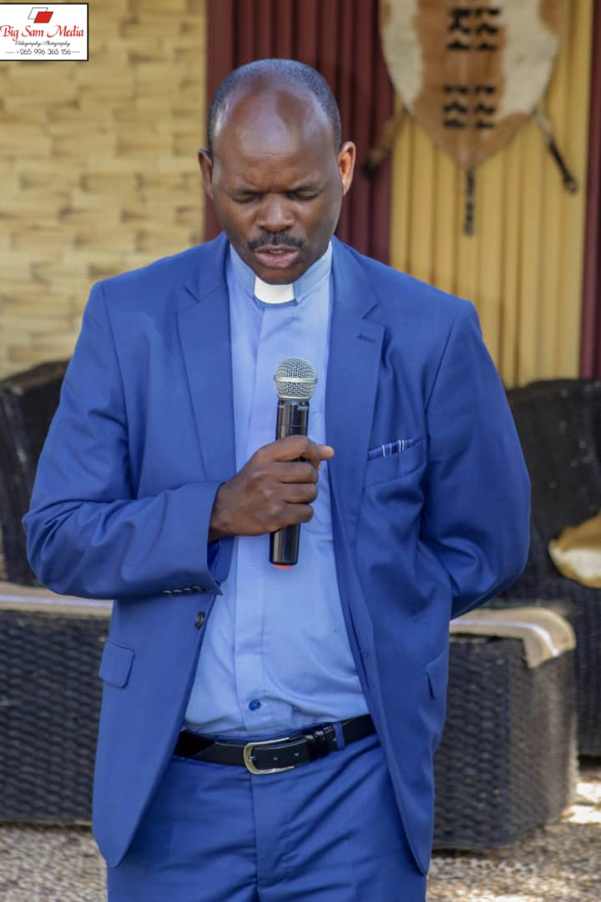
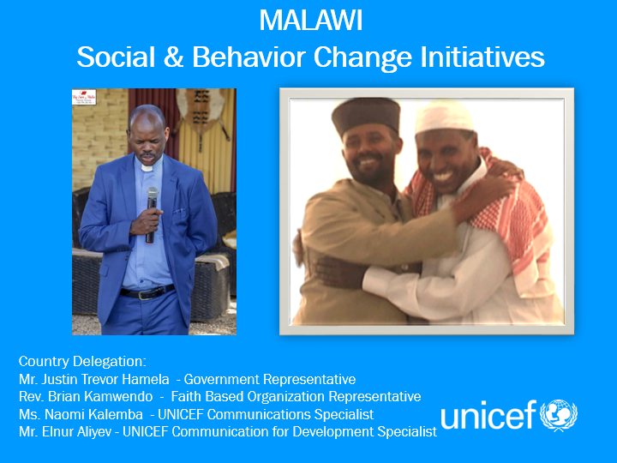
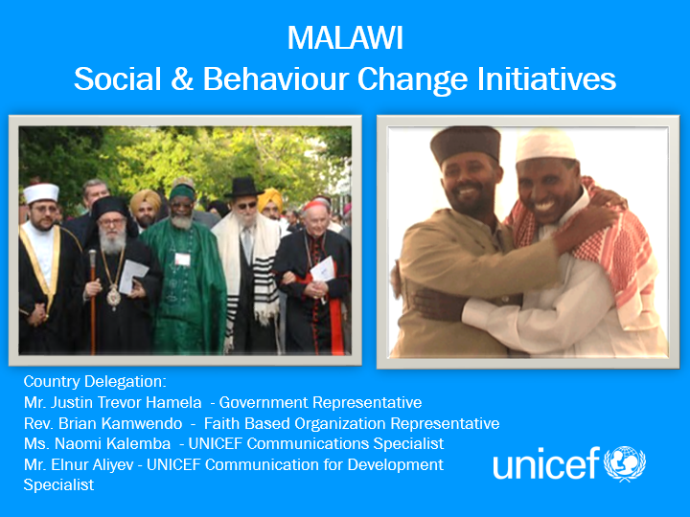
MALAWI
Social & Behavior Change Initiatives
Country Delegation:
Mr. Justin Trevor Hamela - Government Representative
Rev. Brian Kamwendo - Faith Based Organization Representative
Ms. Naomi Kalemba - UNICEF Communications Specialist
Mr. Elnur Aliyev - UNICEF Communication for Development Specialist

Slide 2
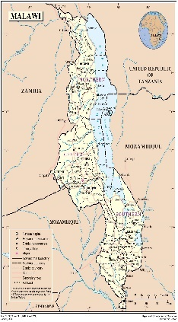
Country Background
Demographic Information
Major Issues Facing Country / Children
Population: 19 million people. 54 % is under the age of 18.
Geographic features: 28 districts, 4 cities and clustered into three Regions (Northern, Central and Southern)
Economic profile: GDP 300 per capita. HDI 170 out of 188 .
Social profile: 65.75% (72.99% male. 58.64% female) of adults can read and write. 75.06% is the youth literacy rate.
63% of children are multi dimensionally poor
Climate change (droughts, floods)
2.8 per cent population growth per annum
85% of population is rural 15% is urban
Harmful social norms, religious beliefs and practices
Key Behavioral and Socio-Cultural
Issues
Existing Research
Formative study on VAC in Malawi.
DHS 2015-2016
Community dialogues on children’s rights.
Situation analysis of children in Malawi.
Study on child marriages
Study on Violence against Children and Young Women of 2013
Healthy seeking practices (IYCF, nutrition)
Creating protective family environment (responsible parenting)
Violence Against Children (VAC) - sexual, physical and emotional.
Child Marriages and early pregnancy.
Education enrolment and keeping girls in school
HIV and AIDS among young people
Notes:
Malawi is a small, landlocked, ethnically diverse and largely rural low income country blessed with fertile soils but afflicted with persistent poverty, inequality and gender discrimination.
Malawi is bordered by Mozambique to the south and east, Tanzania to the north and Zambia to the west. Lake Malawi, the third largest lake in Africa, runs along most of its eastern border.
The population of Malawi is currently growing at 2.8 per cent per annum, compared to a global average of 1.1 per cent and an Africa-wide average of 2.6 per cent. Over the past three decades, as under-five mortality declined by 73 per cent, the total fertility rate fell only 34 per cent. As a result, the population has grown rapidly, increasing from about 4 million in 1966 to close to 17 million today - and is expected to reach 30 million by 2030. Population density - estimated at 139 persons per square kilometre in 2008 and ranging from 36 in Rumphi to over 3000 in Blantyre City - is likely to reach around 280 persons per square kilometre by 2030. Given Malawi’s dependence on natural resources, high rates of population growth will have far-reaching implications for sustainable development.
Malawi is currently a youthful country with a median age of 16.7 and approximately 54 per cent of the population under the age of 18. The country was ranked 170/185 on the UNDP Human Development Index. Assuming the same age proportions, there are 8.8 million children in 2015, which will expand to 16.2 million by 2030 and 27 million by 2050.
As of mid-2017, the population of Malawi’s 28 districts clustered into three Regions (Northern, Central and Southern) was estimated at around 17.4 million.
As opposed to the patrilineal north, the southern districts generally follow a matrilineal marriage tradition where men move to their wife’s village after marriage.
As Malawi undergoes a process of modernization and development, tensions between traditional norms and new expectations and attitudes (as embodied in recent and future laws and policies) are likely to arise. How these play out and are managed will have significant implications for the situation of children and women going forward. World Population Prospects 2017 Revision - UN Department of Economic and Social Affairs, Population Division.
Population Census, 2008 and Population Projections, 2013, NSO.
Human Development Index, UNDP, 2016.
See for example publications by Malawi Human Rights Commission, 2013.

Slide 3
Religious Context
600 Churches, 2,500 Madrasas/Mosques etc.
37% Religion-Based Schools/Universities
62% Faith-Based Social Services (CHAM)
Presidential Advisor on Civil Society and Religious Affairs
Key Religious Institutions
Existing Modality of Engagement between UNICEF CO and FBO
PCA with the Church of Central Africa Presbyterian through Malawi Interfaith AIDS Association (MIAA)
Main Government partners associated with FBO engagement: Ministry of Gender, Children, Disability and Social Welfare
Notes:
What are the main religious denominations and traditional groups operating within the country?
Protestant 27.2% (includes Church of Central Africa Presbyterian 17.7%, Seventh Day Adventist/Baptist 6.9%, Anglican 2.6%), Catholic 18.4%, other Christian 41%, Muslim 12.1%, other 0.3%, none 1% (2015-16 est.)
There are 15 ethnic groups in the country, each with their own customs and traditions. The major ethnic groups include the Tumbuka and Tonga in the Northern Region; the Ngoni in the Northern and Central regions; the Chewa in the Central Region; and the Yao, Lomwe, Sena, and Mang‛anja in the Southern Region. Chewa 35.1%, Lomwe 18.9%, Yao 13.1%, Ngoni 12%, Tumbuka 9.4%, Sena 3.5%, Tonga 1.8%, Nyanja 1%, Nkhonde 0.9%, other 1.8% (2015-16 est.)
https://www.indexmundi.com/malawi/demographics_profile.html
http://www.earth-cultures.co.uk/cultures/people-of-malawi
https://www.indexmundi.com/malawi/demographics_profile.html

Slide 4
Key Components of Engagement With Faith Actors on SBCC
Components
Main Participants/Target Groups
1. Knowledge delivery platforms
(religious education schools/
universities)
2. Media platforms
(broadcast and print media)
3. Community based platforms
(faith based community groups)
4. Service delivery platforms
(churches/mosques)
Religious leaders, students of religious education schools.
Parents and caretakers, young people and children.
Parents, caretakers, young people, religious groups chiefs.
Community members, parents and caretakers

Slide 5
Key Expected Outcomes of Faith for SBCC Initiatives
Outcome 1
FBO Engagement to end child marriages
Improved engagement and empowerment of religious communities in ending child marriages, violence against children and gender based violence.
Outcome 2
FBO Engagement for girls’ education
Improved engagement of and empowerment with knowledge and skills of parents and caretakers to support and send their girls, especially 10-14 years to school.
Parents and caregivers, with a focus on adolescent mothers, have the capacity to engage in responsive and positive parenting practices
Outcome 3

Slide 6
Implementation Strategies/ Faith-Based Mechanisms / Materials
Individual-Family Level
Empowerment with knowledge and skills of family units on leadership responsibilities from faith institutions to promote child rights at household and community level.
Men-Only forums on Gender based violence against women and men at household and community level.
Women-only forums on gender based violence (GBV) against women and men at household and community level.

Slide 7
Implementation Strategies/ Faith-Based Mechanisms / Materials
Community Level
Community engagement and empowerment with knowledge and call for actions to promote child rights through
  annual open air campaign on child protection and zero tolerance on violence against women.
  community dialogues, participatory theatre and retreats with youth in faith groups.
  Development and broadcasting community radio (radio Islam and Maria) programmes and engagement with radio listening clubs for outreach.

Slide 8
Multi-Media Components / Plans to Engage Through Media
Engage and mobilize with
Faith Leaders
Engaging faith leaders to tell their stories on their activities in ending child marriages. The stories are aired on radio and television and printed in the daily news (Times Media Group News Paper)
Faith Based Radio Stations
Engaged (Radio Maria, Presbyterian Radio and Radio Islam) to broadcast stories of religious leaders championing community based ending child marriage projects
Media Context
41%
12%
46%
10%
Radio
TV
Mobile
  Internet

Slide 9
Implementation Strategies/ Faith-Based Mechanisms / Materials
Institutional/organizational level
Launch of Child Protection within the faith community and annual commemoration of the International Day of Prayer and Action for Children (20th November of each year)
Capacity and capability of religious institutions/organization in promotion of children’s right at household and community level.
  Development of Resource Manual for Religious Leaders on Child Protection with reference to the Holy Scriptures.
  Workshop for Religious Leaders and Traditional Leaders in human rights, Children's Rights and sexual reproductive Health Rights of women
  Orientation of Sunday School, Madras Teachers and Youth Leaders in Spiritual Counselling for Children (victims of abuse and neglect)
  Orientation of Theological College Tutors on child protection and mainstreaming of child protection issues in theological formation.
  Orientation of marriage counsellors within the faith community on child protection and mainstreaming into their agenda.
  Reinforce legislations and policies that protect children at district and community levels.

Slide 10
Implementation Strategies/ Faith-Based Mechanisms / Materials
Policy/System Level / Advocacy Strategies
Advocacy with religious groups: Church of Central Africa Presbyterian (CCAP) and Malawi Interfaith AIDS Association (MIIA)
revise training materials for Sunday school; and review the curriculum for theological college/department of universities.
Prepare and distribute policy and program briefs on child rights and responsibilities
Advocacy videos/documentaries for mass media
Public declarations, signing of pledges, calls to actions, forming of children’s committees, inter-faith-donor forums
Issuance of Pastoral letters (a key advocacy tool for the faith community)

Slide 11
Main Achievements / Results under the MIAA partnership 2012 -2014
275 child marriages were dissolved and 198 teen mothers enrolled back to schools.
The targeted 50% reduction in marriages officiated in Churches/Mosques for girls below the age 18 years by attaining 74.4% reduction rate.
Increase of reported cases of abuse to the Churches/Mosques by children and parents seeking support.
Churches and Mosques have now experienced increase in recorded referrals to other child protection services from an initial 11% to 90%.
88 GBV cases were reported to religious leaders for appropriate counselling and 52 cases were sent to Victim Support Units (VSUs).
A total of 600 Churches/Mosques have adopted the Day of Prayer for Child Protection as an advocacy initiative within their congregations.

Slide 12
Main Challenges
Type | Issue | Attempts to Address
Political | Limited evidence on faith engagement in SBCC | National capacity development assessment on SBCC conducted.
Organizational | Despite the launch, limited funding to roll out mainstreaming of child protection within the faith community i.e pre-service curriculums Limited capacity of FBOs to mainstream messages into religious ceremonies. Some churches/mosques are strong and resisting to change due to prevalence culture over religion. | Development and revision of teaching manuals/curriculums. Series/continued capacity development of religious institutions. Series of face to face discussions and consultations on religious values vs cultural values.
Logistical | limited support to coordination structures that support child protection work | UN Joint Programme on Girls’ Education engages traditional and religious structures to support CP work as well.
Other | There is need for capacity building of faith leaders and the faith structures for children. Girls withdrawn from marriages are often not provided with support to remain in schools. | Capacity building is ongoing with MIAA for religious leaders. Media Houses are engaged to end child marriages.

Slide 13
Key Lessons Learned
Most of the Faith Groups in Malawi have adopted and adapted the Child Protection paradigms in their activities.
Influential religious champions are corporative in Child Protection, Gender and Behaviour Change Interventions
The Government of Malawi’s political will has enhanced a positive impact on various issues regarding behaviour change
The amendment of the constitution on the age of the child and age of marriage and the harmonization of the other pieces of legislation following the constitution amendment.
In Malawi the churches are easy and open to work with Religious champions are also easy and open to work with especially if their church has endorsed their activities.

Slide 14
FUTURE PLANS
for Expanding Strengthening, Scaling-Up or Sustaining Engagement
on Faith for Social and Behaviour Change
Strengthening evidence for action to work with FBOs across SBCC process
Improving integration and synergy between religious and traditional institutions.
Improving engagement of community based religious groups to utilize IPC channels to reach people with messages and call for actions.
Improving social partnership for change with FBOs in promotion of child rights.
Strengthening faith based media’s capacity and capability to reach people with messages and call for actions.
Improving monitoring, assessment, reporting and documentation of best practices to scale up at national level.

