Slide 1
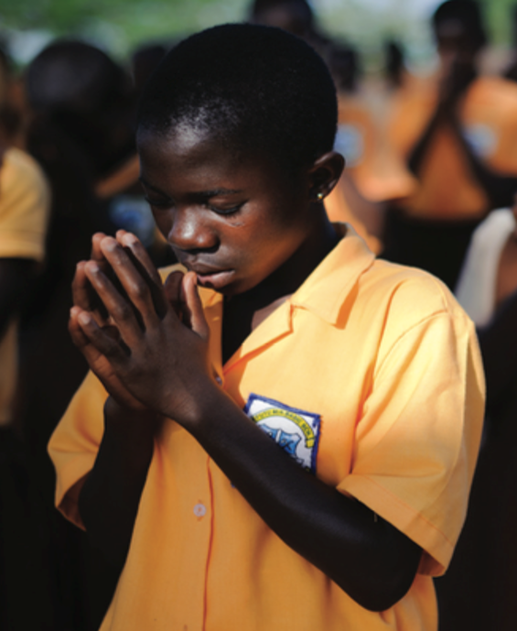
FAITH IN ACTION
COVID-19 INITIATIVE
Regional Webinar
Deepika Singh – RfP
Kerida Mcdonald - UNICEF

Slide 2
Faith and Positive Change for Children, Families & Communities
Child & Family Wellbeing
- SBCC Practice - Tech knowledge on children - Liason between Govt & Civil Society - High level advocacy on child rights issues
-Inter-faith convenors at Global, Regional and CO level :
Religious Leaders, Inter-Faith Councils and Local Faith Communities
- Knowledge leadership on Evidence on Faith & Dev.
- Convenors of Int’l Faith-Based NGO Partners

Slide 3
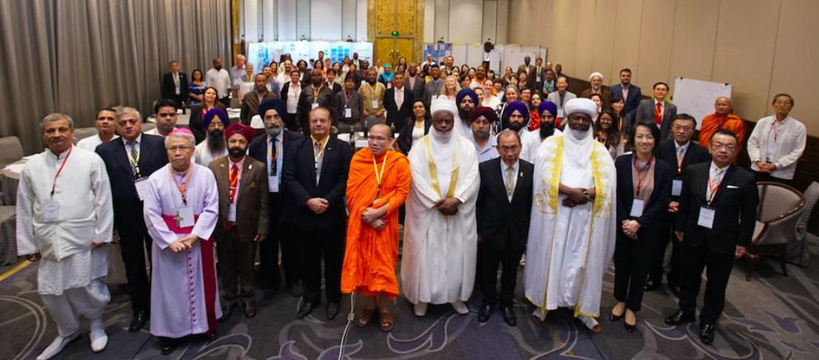
UNICEF Global Consultative Workshop on Faith for SBCC Initiative
Bangkok, Thailand July, 2018

Slide 4
FPCC Advisory Group of International FBOs
(not all agencies in the group are visually represented)

Slide 5
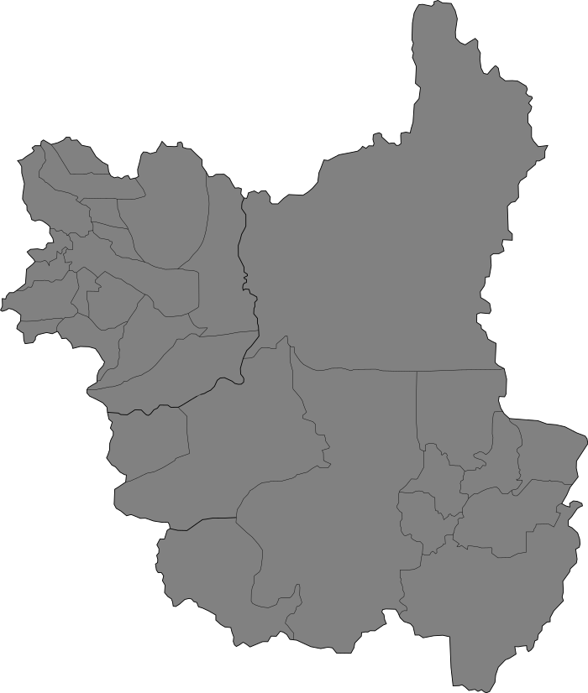
Work Rocks in 6 Focal Countries
Malawi
Faith & Positive Change
for Children
Early Adopter Countries
South Sudan
Kenya
Liberia
Niger
Cameron

Slide 6
Religions for Peace Movement
Active in more than 90 countries, in six regions, and on the global level.
Africa | Asia | Europe | Latin America & the Caribbean | Middle East/North Africa | North America

Slide 7
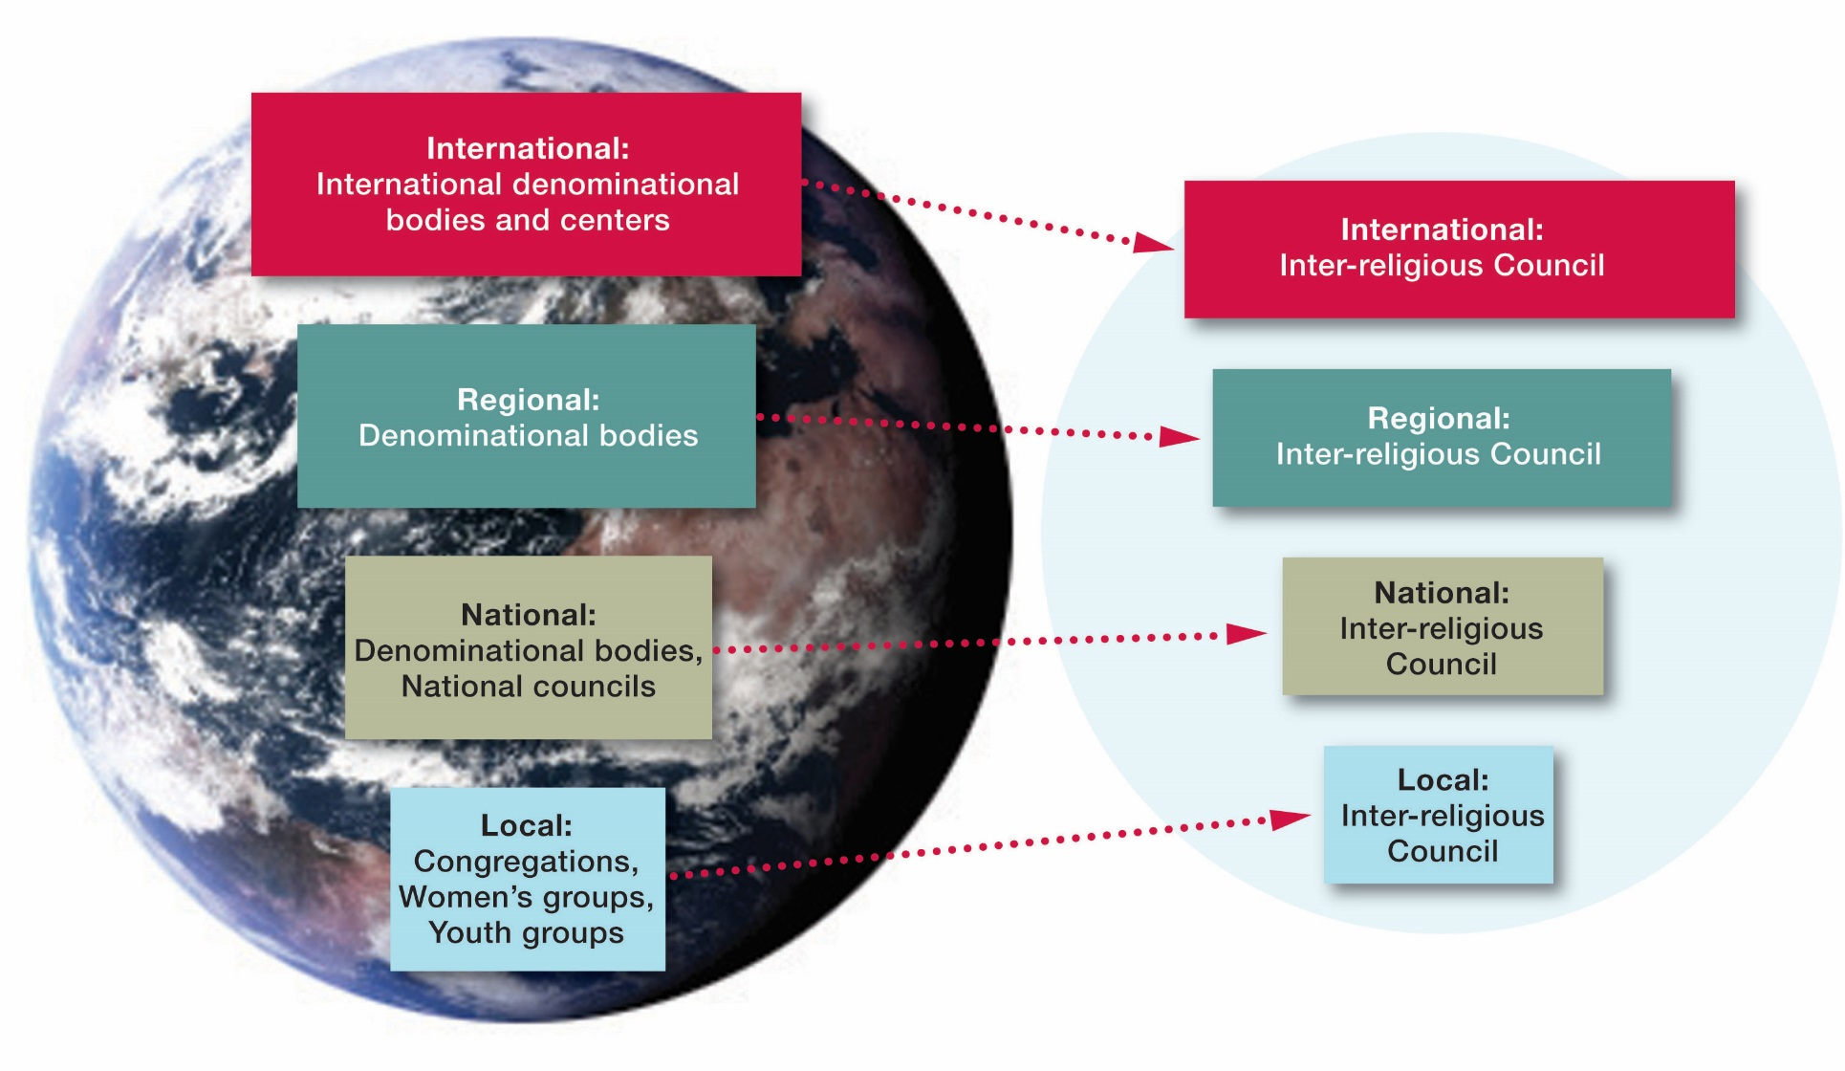
Religions for Peace Structure

Slide 13
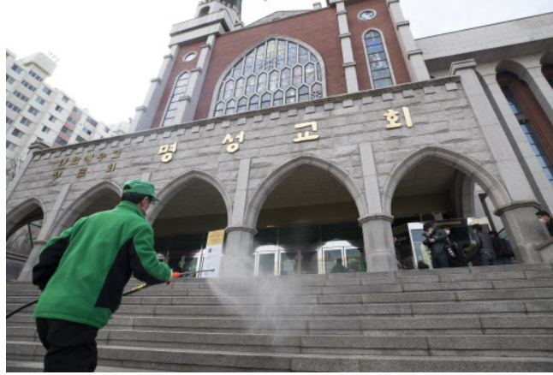
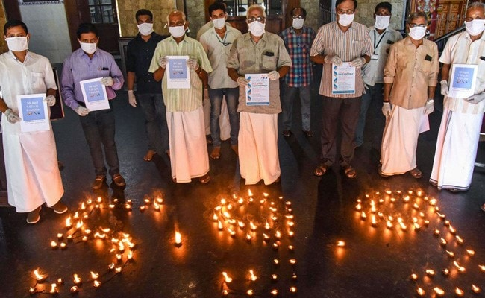
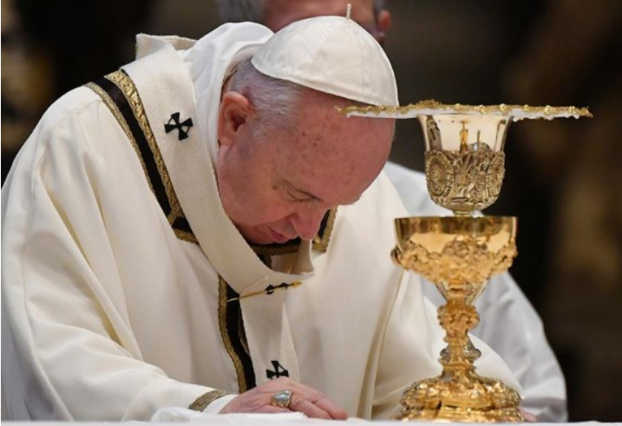
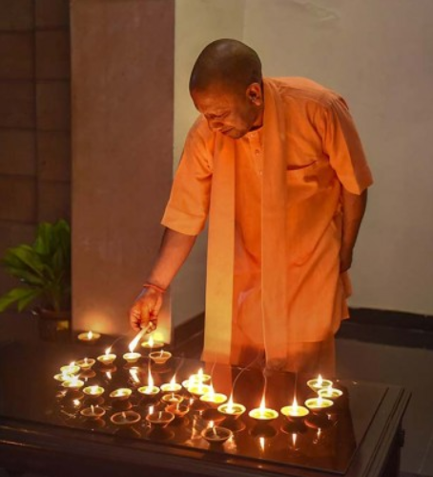
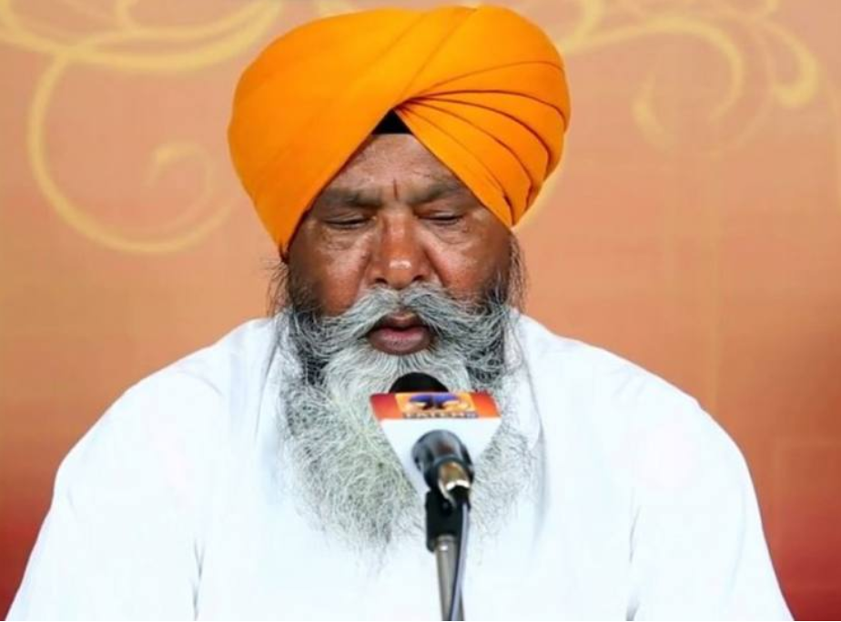
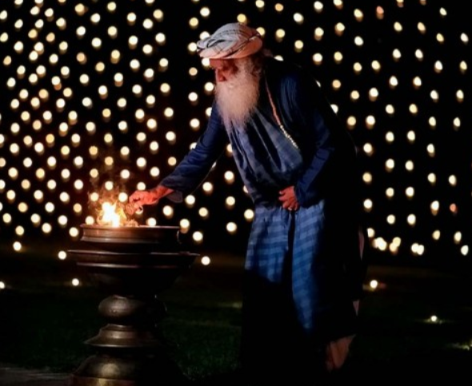
Key Objectives of the Campaign
Manage communication, misinformation and rumours
Dispel fear, stigma, discrimination, reduce tensions and promote social harmony
Promote adaptation of religious gatherings, practices rituals, handwashing & hygiene
Address specific needs of vulnerable groups
Prevent violence against children/youth and their active engagement in the initiative
© UNICEF/UN0306241
Promote and support the recovery of social services, resilitence and return to normalcy

Slide 14
Six #FaithInAction COVID-19 Strategiesnitiative
ns of Multi-Faith Campaign/Initiative
1
High Level Advocacy at global, regional and national level
4
Digital Engagement
For continuous communication and engagement of communities and young people
2
Evidence for Action
Collection of information on knowledge, attitudes and practices
5
Exchange for Action
Periodic webinars – to be coordinated by RFP and UNICEF
Exchange through Webplatform “home”
Global Guidance on Key and Emerging Issues
Development, dissemination and local customization of Global Thematic Resource Guide
3
6
Tracking, monitoring and documentation
the results of the initiative
© UNICEF/UN0306241

Slide 15
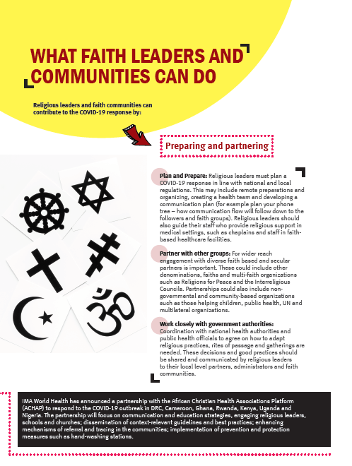
Global Thematic Resource Guides for Religious Leaders
Communication in Times of Corona
Mental & Spiritual Health, Mis-Information and Rumours, Stigma & Discrimination
Maintaining Hygiene & Health: Adaptation of Ceremonies, Burial Practices, Rituals, Hygiene & Handwashing
Addressing Vulnerable Groups: Elderly, Homeless; Migrants, Disabilities, Pregnant Women and children
Preventing Violence Against Women & Children
Supporting Recovery of social services: Immunization and Back to School
Children and Youth Participation
Digital and Media Engagement
Notes:
Religious leaders using Newsletters, booklets and Youtube videos to reach out to followers during COVID-19 crisis

Slide 16
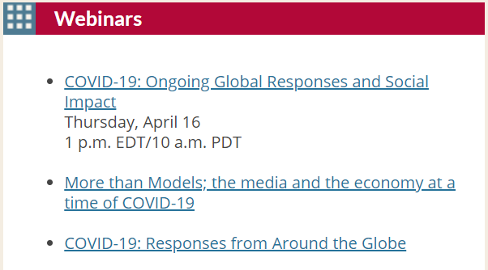
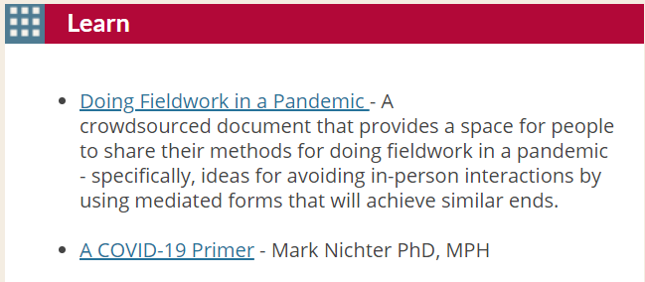
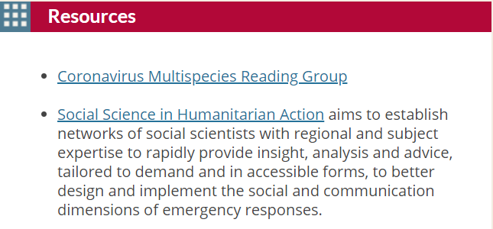
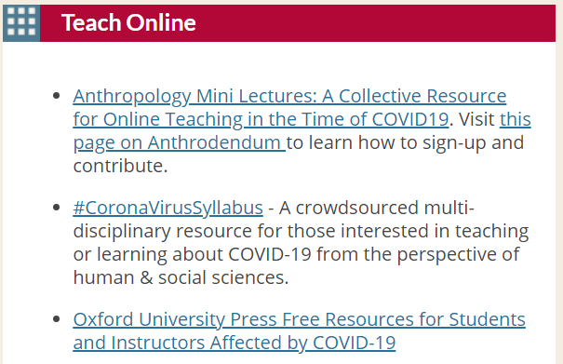
Evidence-Informed Communication and Action Eg. through Partnership With Global & American Anthropological Association
https://www.americananthro.org/COVID-19

Slide 17
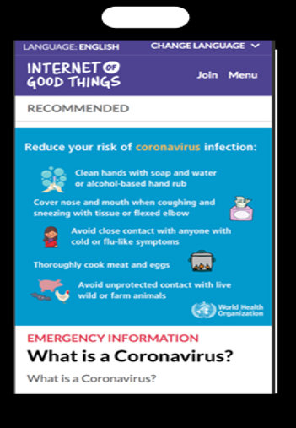
Leveraging of UNICEF-supported Digital Platforms
Internet of Good Things
U-Report Faith Reporters
Leverage reach of faith community members personally to provide greater depth of information including:
Culturally adapted Messages for platforms like Facebook, FB Messenger, Chatbots, Twitter, WhatsApp, Instagram, YouTube, WeChat, Tik Tok
IOGT, U-Report, Voices of Youth
Plan for reaching the largest target audience through Broadcast, Radio, Print, and Social Media platforms such as Tik Tok, U-Report, IOGT and Chatbots on Covid-19

Slide 18
Faith Leaders Messaging on COVID-19

Slide 19
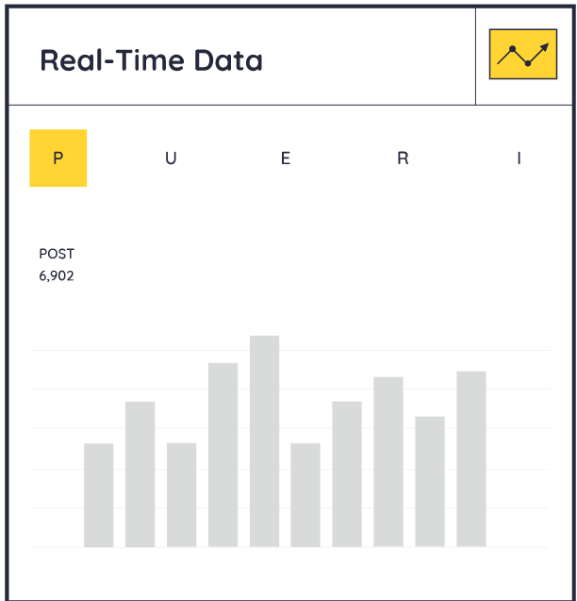
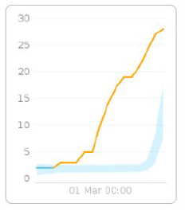
Tracking, Monitoring & Documentation of Campaign Country, region, religion and targeted community where applicable
Coordination, Capacity & Partnerships: Extent of RfP-UNICEF coordinaton, Inter-Faith Coordination; Inclusion of less-established Faith & Traditional grps, engagement of Women of Faith; Youth in Faith; Outreach to most vulnerable groups; Linkage w/ Govt-led RCCE structure; Digital Engagement capacity; Data Collection/needs assess. to inform communication and action
Overall Reach of Communication – Media: Mobile, Radio, TV; Social Media; Traditional Religious Channels:
Content Analysis – Content on prevention, safer behaviour, stigma and discrimination; support for vulnerable segments esp children, women, migrants; communal harmony; religious teachings
Impact of engagements: recall & knowledge; change in attitudes / perceptions; adoption of behaviours, adaptation of practices;
Opportunities to provide feedback, express opinions and engage in the response
1
2
3
4
5

Slide 20
7 Joint Webinars
 | Date | Region | Language | Participants
1 | 19 April | East Asia and the Pacific | English | 60
2 | 21 April | East and Southern Africa | English | 167
3 | 22 April | West and Central Africa | French | 95
4 | 6 May | Latin America | Spanish | 133
5 | 6 May | Caribbean | English | 43
6 | 7 May | South Asia | English | 81
7 | 21 May | Middle East and North Africa | Arabic | 115
Total 694

Slide 21
Examples of Faith-in-Action COVID-19 Response
National Days of Prayer
Monthly inter-faith devotionals promoting “culture of care”
Coordinated Advocacy Statements from Senior leaders, Letter to Faith Communities
Increase access to information:
Joint Media awareness raising
Multi-media communication by inter-faith network
Development and dissemination of thematic awareness-raising materials
Fund-raising drives and distribution of basic supplies
Healthcare assistance
Mitigation of inter-faith conflict
Refugee Asylum
Assistance for mental health
Partnership with civil society
Youth Peer Support to affected youth

Slide 22
Main Issues and Challenges: COVID-19 Response
Resistance against closing houses of worship
Practicing Physical Distancing within vulnerable groups including refugee/migrant camps
Managing Rumours and Misinformation
Inter-personal violence / Conflicts linked to food access
Increased abuse from men in households against women and children
Confusion about how to live in this “new normal”

Slide 23
Priority Needs and Asks: COVID-19 Response
Assistance in appropriate messaging that can be contextualized
Balanced messaging with incorporation of both science and religious teachings - supported by religious scholars
Access to resources for outreach activities - Platform of resources to help respond quickly to those in need
Mobilization of psychological services for children, women and other vulnerable groups
Increase national efforts with more systematic collaboration between national and sub-national
Support for inclusion of less established faith and traditional groups

Slide 24
Next Steps
Roll out of the initiative at the regional and country level
Finalization, dissemination and adaptation of guidance documents
Development of action plan
Engagement of Interfaith Youth Networks in digital platforms
Regular webinars
Systematic engagement and involvement of the FBOs

