Slide 1

Infection Prevention and Control (IPC) for Novel Coronavirus (COVID-19): Guidance for Faith-based Communities and Religious Leaders
WHO IPC Technical and Clinical Unit
Notes:
Facilitator notes: Introduce the course by stating the training course name. Introduce yourself.

Slide 2
Presentation Outline:
Module 1: Introduction to IPC for COVID-19
Module 2. Safe Gathering Practices during Faith-based Activities
Module 3: Safe Burial Practices
Module 4: Faith Leaders’ role in COVID-19 education
Notes:
Facilitator notes: Read out loud to the participants the training outline, including the names of each module

Slide 3
Infection Prevention and Control (IPC) for Novel Coronavirus (COVID-19): Guidance for Faith-based Communities and Religious Leaders
Module 1: Introduction to IPC for COVID-19
WHO IPC Technical and Clinical Unit
Notes:
Facilitator notes: Introduce Module 1: IPC Introduction for COVID-19

Slide 4
Module 1 Objectives:
By the end of this module, the participant should be able to:
Define infection prevention and control (IPC)
Identify the significance of IPC for COVID-19 and faith-based organizations
Notes:
Facilitator notes: Review the main objectives for Module 1 with participants. Allow participants to ask any questions they may have about the content of this module. Remind participants that the module’s objectives are like a “guarantee” of what they will learn!

Slide 5
What is infection prevention and control?
Infection prevention and control is:
a scientific approach with…
  practical solutions designed to prevent harm, caused by infections, to patients and health care workers
  grounded in principles of infectious disease, epidemiology, social science and health system strengthening, and
  rooted in patient safety and health service quality
Source: WHO Infection Prevention and control web pages;; https://www.who.int/gpsc/ipc/en/
Notes:
Facilitator notes: Define Infection Prevention and Control. Emphasize that IPC practices are evidence-based practices, meaning that they have been scientifically validated to be effective at reducing the transmission of microorganisms. When implemented correctly, transmission of harmful microorganisms can be reduced to ensure the health and well-being of patients and HCWs.

Slide 6
IPC: A basic requirement for outbreak preparedness and a critical element of readiness
Infection Prevention and Control (IPC)
should be an ongoing activity undertaken/supported by the national programme and by the IPC focal point/team/committee, the health care facility senior management officials and
all staff at the facility level.
Notes:
Facilitator notes: Emphasise to participants that IPC is not a one-time thing. IPC is a continuous collection of activities that must be supported at each level of a healthcare system. There should be two major IPC groups/committees. One group should be housed at the National level, who has an IPC Focal Person, who liaises with all other national and district level focal persons. The other group/committee should be based at the healthcare facility level.

Slide 7
Why is IPC important for COVID-19?
When implemented and performed correctly, IPC practices can:
Reduce the transmission of COVID-19 among faith-based community members during gatherings, ceremonies, and rituals
2. Enhance the ability of the faith-based organizations to respond to the COVID-19 outbreak in safe manner. ​
Notes:
Facilitator notes: Inform the participants of the benefits of IPC. Ask the participants if they can think of any other ways IPC is important, especially related to COVID-19. Allow participants to provide some answers. Have a brief group discussion as to why participants think IPC is important for COVID-19.

Slide 8
Infection Prevention and Control (IPC) for Novel Coronavirus (COVID-19): Guidance for Faith-based Communities and Religious Leaders
Module 2: Safe Gathering Practices during Faith-based Activities
WHO IPC Technical and Clinical Unit
Notes:
Facilitator notes: Introduce the next module to participants: Standard Precautions.

Slide 9
Module 2 Objectives:
By the end of this module, the participant should be able to:
Identify ways to conduct safe faith-based gatherings (when permitted) while adhering to IPC precautions
Introduce novel ways to conduct faith-based activities
Notes:
Facilitator notes: Review the module objectives with participants. Allow participants to ask any questions before beginning the module. Also, allow participants to ask questions while you are reviewing content.

Slide 10
IPC Practices for Safe Gatherings:
1. Maintain at least 1-meter distance during ceremonies, gatherings, rituals
  COVID-19 is spread by droplets, which can land on people, during singing, coughing, and sneezing
  If possible, plan the event outdoors. If not possible, ensure the venue of the gathering has sufficient ventilation
  Regulate the number and flow of people at the gathering/worship space
  Having small groups, over large mass gatherings, should be considered and encouraged when possible.
Notes:
Facilitator notes:

Slide 11
IPC Practices for Safe Gatherings:
The number and flow of pilgrims at pilgrim sites should managed by respecting physical distance between individuals
Identify a space at the venue or gathering site for individuals who may become sick and need to be isolated away from other gathers
2. Preventing Touching between People attending Faith Services:
  Create new ways for community members to greet each other to reduce the transmission of COVID-19
Notes:
Facilitator notes:

Slide 12
IPC Practices for Safe Gatherings:
Replace hugs, kisses, and handshakes with bows, peace signs, or using sign language greetings while maintaining physical distance
Greet people with smiles and friendly words, instead of physical touching
3. Prevent touching, handling, and kissing of devotional objects during faith-based ceremonies, gatherings, and rituals
  COVID-19 can live on surfaces anywhere from a few hours to days
Notes:
Facilitator notes:

Slide 13
IPC Practices for Safe Gatherings:
Given this property of the virus, identifying alternative ways to handle communal objectives and symbols safely is encouraged
  For example, bow to sacred statues or icons, instead of touching or kissing them
  Receive a blessing from at least 1-meter away and avoid the distribution of Holy Communion
  Consider using pre-packed, individually wrapped religious or ceremonial foods
  Empty fonts of holy water to avoid individuals placing their hands in the water
  Eliminate rituals that involve physical touching (i.e. foot washing)
Notes:
Facilitator notes:

Slide 14
IPC Practices for Safe Gatherings:
Encourage health hygiene among participants in faith services and other activities when gatherings are permitted
  Provide hand hygiene stations and encourage hand hygiene practices before and after services or gatherings.
  Provide feet washing facilities before worshipers enter a communal space
  Ensure disposable facial tissues are available and waste bins to place used tissue are available
  Ask worshipers to bring their own prayer rugs to place over the carpet for daily prayers
Notes:
Facilitator notes:

Slide 15
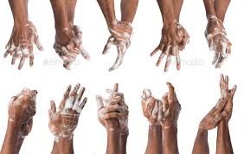
Standard Precaution #1: Hand Hygiene
The single most important IPC precaution
Provides the most effective means to prevent the transmission of pathogens to patients or healthcare workers within a healthcare facility
Is a generic term that incorporates three methods:
  Handwashing (soap/water)
  Alcohol hand rub
  Surgical hand antisepsis
Notes:
Facilitator notes: Inform participants that hand hygiene is the most important IPC precaution. Emphasize to participants that hand hygiene is an overarching or umbrellas term for three different methods used to clean/disinfect the hands. Inform participants that that the three hand hygiene methods include: handwashing with soap/water, alcohol hand rub, and surgical hand antisepsis.

Slide 16
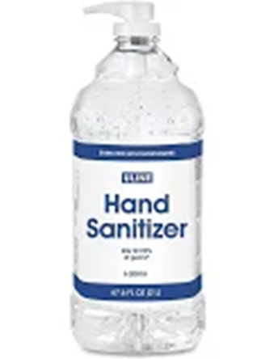
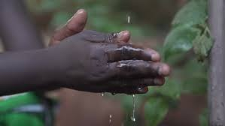
Standard Precaution #1: Hand Hygiene
Hand washing with soap and water should be the first-choice hand hygiene method when hands are visible soiled
When hands are NOT visible soiled, alcohol hand gel is the preferred hand hygiene method.
  Other reasons to use alcohol hand gel:
  More effective at killing microorganisms than anti-microbial agents and soap/water when hands are NOT visible soiled
  2. Requires less time than handwashing
  3. Can be performed anywhere
  4. Do not require sink (running water), soap, or paper towels
Notes:
Facilitator notes: State when to use handwashing with soap/water versus alcohol hand gel. Inform participants of the benefits of alcohol hand rub. If they have the availability to have this resource available to them, then this product should be used when hands are NOT visible soiled.

Slide 17
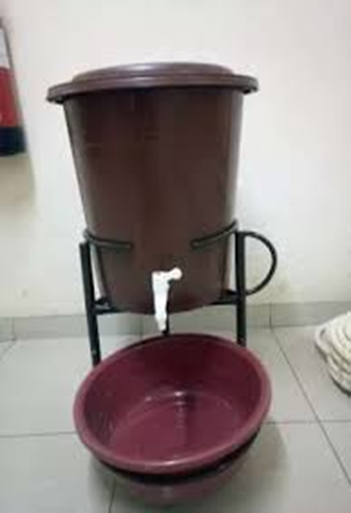
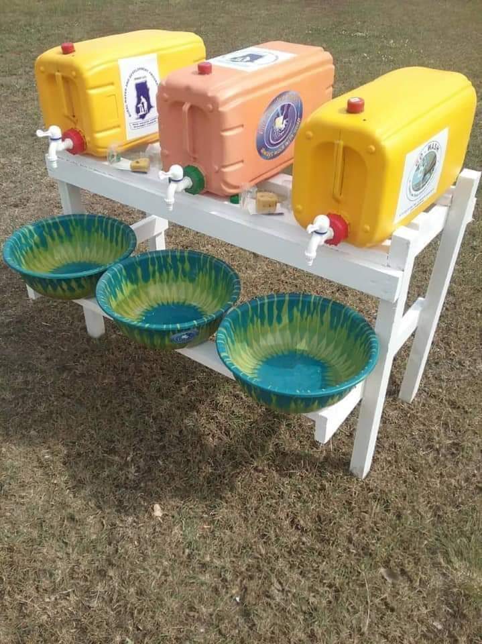
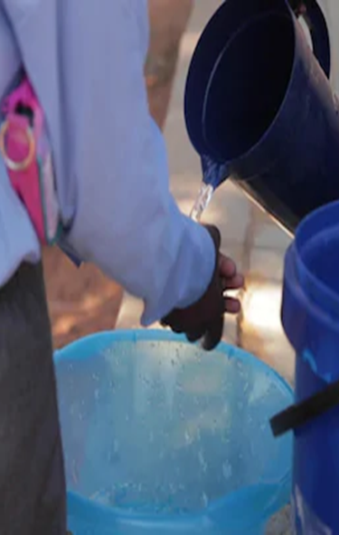
Hand Hygiene:
Some considerations for implementing hand hygiene stations and practices for faith-based gathering during COVID-19 in African settings:
  If liquid or bar soap is not available, chlorine (0.05%) can be prepared and placed within veronica, jerry can, and water jugs for hand hygiene
  Examples of hand washing stations that do not require running water:
Notes:
Facilitator notes:

Slide 18
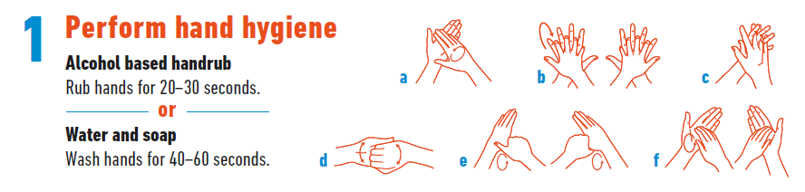
Standard Precautions #1: Hand Hygiene
How to Perform Hand Hygiene:
Regularly and thoroughly with alcohol-based hand rub or wash them with soap and water according to the WHO 6 steps:
Rub the palms
Back of palms
Interlace fingers
Interlock and cup fingers
Thumbs
Fingertips and under nails
Source: https://www.who.int/gpsc/5may/Hand_Hygiene_When_and_How_Leaflet.pdf?ua=1
Notes:
Facilitator notes: If possible, physically demonstrate to participants how to wash their hands, either using a veronica bucket of tippy tap when conducting this training, if a sink with running water is not availalbe. Go through each of the hand hygiene motions with participants. Allow participants an opportunity practice the hand hygiene steps if possible.
Make sure to remind participants to rub the dorsum of the hand and to clean under their nails. These are two commonly overlooked areas when engaging in hand hygiene.

Slide 19
Standard Precaution #2: Respiratory Hygiene
What is Respiratory Hygiene?
A precaution that prevents the transmission of all respiratory infections in a healthcare setting. These precautions should be established at the first point of contact with patients at the healthcare facility.
Good respiratory hygiene/cough etiquette can reduce the spread of microorganisms (germs) that cause respiratory infections (colds, flu).
Notes:
Facilitator notes: Inform the participants that the second standard precaution that will be discussed is respiratory hygiene. Define respiratory hygiene (etiquette). Explain why respiratory hygiene (etiquette) is important. Ask participants why respiratory hygiene is important for COVID-19? Some potential responses include: reduces the transmission of virus into the environment or on surfaces, minimizes the amount of infection in the air, keeps the virus contained.

Slide 20

Standard Precaution #2: Respiratory Hygiene
Steps for respiratory hygiene:
Cover your nose and mouth when you cough or sneeze. Do so by using your inner elbow, inside your shirt, or by using a tissue.
If a tissue is used, discard the tissue immediately into the bin.
Always face away from others when coughing/sneezing
Wash your hands after coughing/sneezing/handling respiratory secretions
Notes:
Facilitator notes: Review the steps involved in respiratory hygiene on this slide. Make sure to point out that there are three ways to correctly perform respiratory hygiene: 1.) with bent elbow, 2.) down a shirt, and 3.) in a tissue. If using a tissues, it must be put into the waste bin immediately. After engaging in respiratory hygiene practices (etiquette), hand hygiene must immediately follow to ensure that if any microorganisms got on your hands while sneezing/coughing that they are rapidly removed.

Slide 21
IPC Practices for Safe Gatherings:
  Encourage worshipers to avoid communal gatherings if they have any symptoms of COVID-19
  When attendees enter a site or building barefoot, show and sandals should be placed separately and in bags.
  Provide visual displays on advice related to hand hygiene, physical distancing, and respiratory hygiene
  5. Frequently clean worship spaces, sites, and buildings:
  Establish cleaning schedules for areas of worship, especially before and after gatherings
Notes:
Facilitator notes:

Slide 22
IPC Practices for Safe Gatherings:
  Frequently disinfect commonly touched surfaces: light switches, doorknobs, stair rails
    Use a disinfectant that is at least 70% ethanol or 0.05% chlorine
    6. When possible, avoid gatherings. Conduct faith-based activities remotely/virtually
    Use technology to maintain community and continue worship
    Use low-technology to maintain faith-based practices in communities (i.e. telephones, compiling and circulating lists for prayers)
Notes:
Facilitator notes:

Slide 23
Infection Prevention and Control (IPC) for Novel Coronavirus (COVID-19): Guidance for Faith-based Communities and Religious Leaders
Module 3: Safe burial practices
WHO IPC Technical and Clinical Unit
Notes:
Facilitator notes: Introduce this next topic area to participants. Participants may not be as familiar with these precautions. Make sure you take time to fully explain and define these terms and their associated sections.

Slide 24
Module 3 Objectives:
By the end of this module, the participant should be able to:
Understand how to provide a dignified and respectful funeral and burial rite during COVID-19
Know how to safely plan and perform funeral and burial rites without causing any infections risks to mourners
Notes:
Facilitator notes: Review the objectives of this module with participants.

Slide 25
Safe Burial Practices:
When acceptable or appropriate, according to respective faith traditions, embalming, burial, and cremation should be allowed for the remains of a person with COVID-19
Religious leaders should work with family and loved ones to ensure that religious and cultural practices are integrated within the ceremony or service
  For example: body washing
    Modifications to the practice will need to be implemented to protect the mourners
Notes:
Facilitator notes: Review the objectives of this module with participants.

Slide 26
Safe Burial Practices:
At a minimum, mourners will need to wear gloves while conducting body washing
If splashing of body fluids is a possibility, additional PPE will be needed (gown, googles, face shield, medical mask)
Family members may view the body, while respecting the 1-meter distance criteria, with no touching or kissing. Hand hygiene is required before and after
It is strongly advised that family members/social support systems who are 60+ years of age, children, and anyone who is immunocompromised/unwell should not engaged directly with the deceased body and maintain a 1-meter distance
Clothes of the deceased person can be laundered with linen. Personal items do not need to be burned; they can be disinfected with 70% ethanol or 0.01% chlorine solution
Notes:
Facilitator notes: Review the objectives of this module with participants.

Slide 27
Infection Prevention and Control (IPC) for Novel Coronavirus (COVID-19): Guidance for Faith-based Communities and Religious Leaders
Module 4: Faith Leaders’ Role in COVID-19 Education
WHO IPC Technical and Clinical Unit
Notes:
Facilitator notes: During this portion of the training, IPC activities and initiatives that can implemented within the community to keep COVID-19 transmission low will be presented.

Slide 28
Module 4 Objectives:
By the end of this module, the participant should be able to:
Recognize ways to encourage communities to follow guidance on COVID-19 to ensure community members do not become infected
Address and counter incorrect or misinformation about COVID-19, especially related to rumors.
Utilize sermons or message to build on your communities about COVID-19 that is in line with doctorine/teaching and practice of respective faith traditions
Notes:
Facilitator notes: Review Module 4 objectives with participants

Slide 29
Faith Leaders Roles
Use accurate information to reduce fear and stigma
Avoid touching eyes, nose, and mouth. Hands touch many surfaces, which then can cause the virus to enter into your mouth, eyes, or nose.
Practice respiratory hygiene.
Stay at home if you feel unwell.
Regularly and thoroughly wash your hands
Maintain physical distance between people at least 1-meter
Notes:
Facilitator notes: Review the objectives of this module with participants.

Slide 30
Faith Leaders Roles
Follow instructions of your local and national authorities
Stay informed and follow advice given my healthcare providers
Stay informed about risk: older people and people with underlying medical conditions are more at risk than others
Notes:
Facilitator notes: Review the objectives of this module with participants.

Slide 31
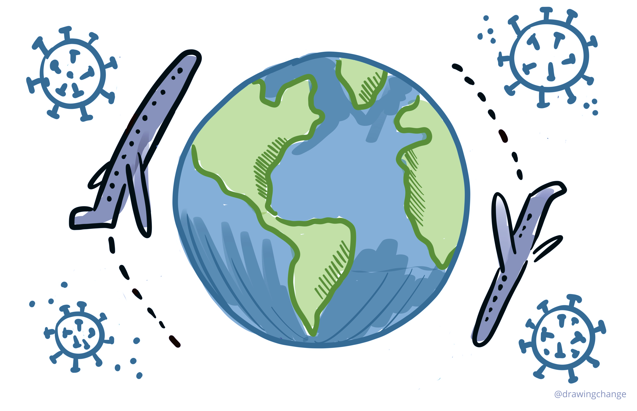

Access free online courses on COVID-19
in your national language!
Italiano
فارسی
日本語
Português
Türk
српски језик
Bahasa Indonesia
Tiếng Việt
हिन्दी, हिंदी
OpenWHO.org

