Slide 1
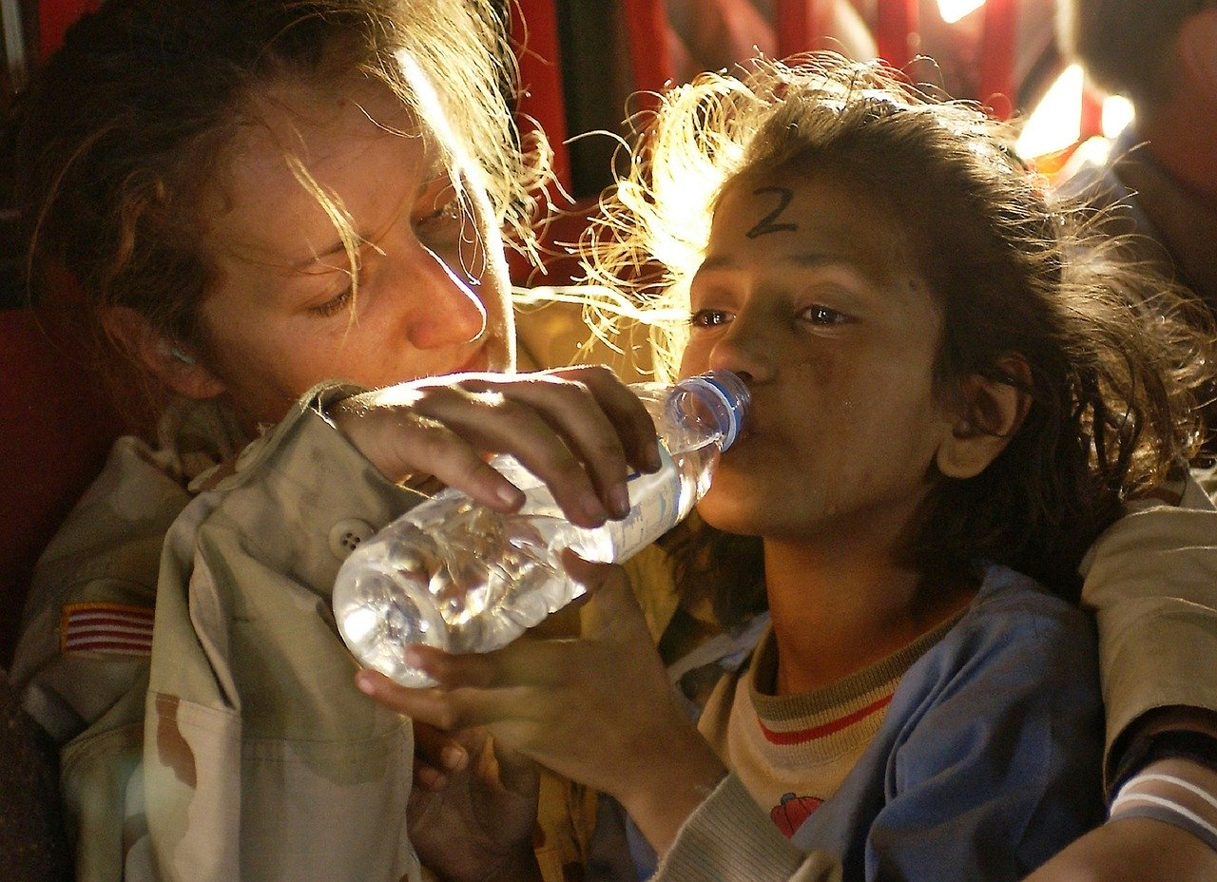
Module 3: Guidance for Vulnerable Groups

Slide 2
Vulnerable Groups for Covid-19
Elderly and people with fragile health
People living in extreme poverty
Pregnant women and Children
People with Disabilities
People experiencing discrimination
People experiencing homelessness
People on the move: Migrants, IDPs

Slide 3
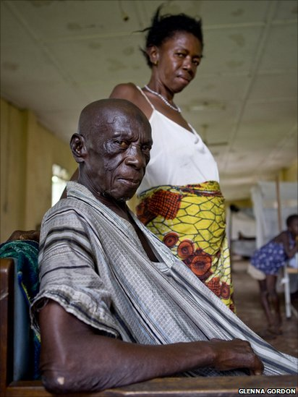
Elderly and people with fragile health
Issues of concern | How religious leaders/Faith Based organizations can help
Most at risk Lower awareness Higher dependency Health conditions Compromised immunity Social isolation Low access to technology Overburdened health services | Support identifying the most-at-risk among communities. Support understanding special needs. Adapt and promote support positive messaging. Engage with care, support vulnerable and affected people. Encourage communities to extend support. Prepare for possible shortage of essentials and medication. Facilitate access of the most-at-risk to services. Mobilize resources and volunteers for support. Engage vulnerable groups in response plans.

Slide 4
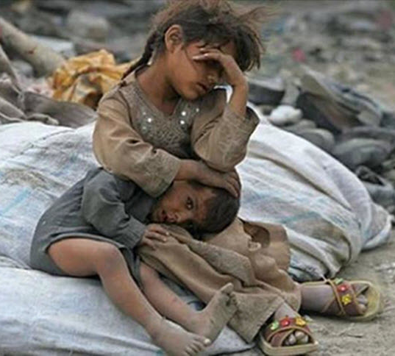
People living in extreme poverty
Issues of concern | How religious leaders/Faith Based organizations can help
Limited access to services and information systems Informal survival economy Occupy vulnerable areas Low political influence Low capacities to cope and adapt to crisis | Support authorities to identify the extremely poor. Understand their needs and potential risks. Adapt and disseminate positive messaging. Engage with care and help to prioritize assistance. Include in decision making processes and response plans. Enhance their capacity to cope, adapt and support their peers.

Slide 5
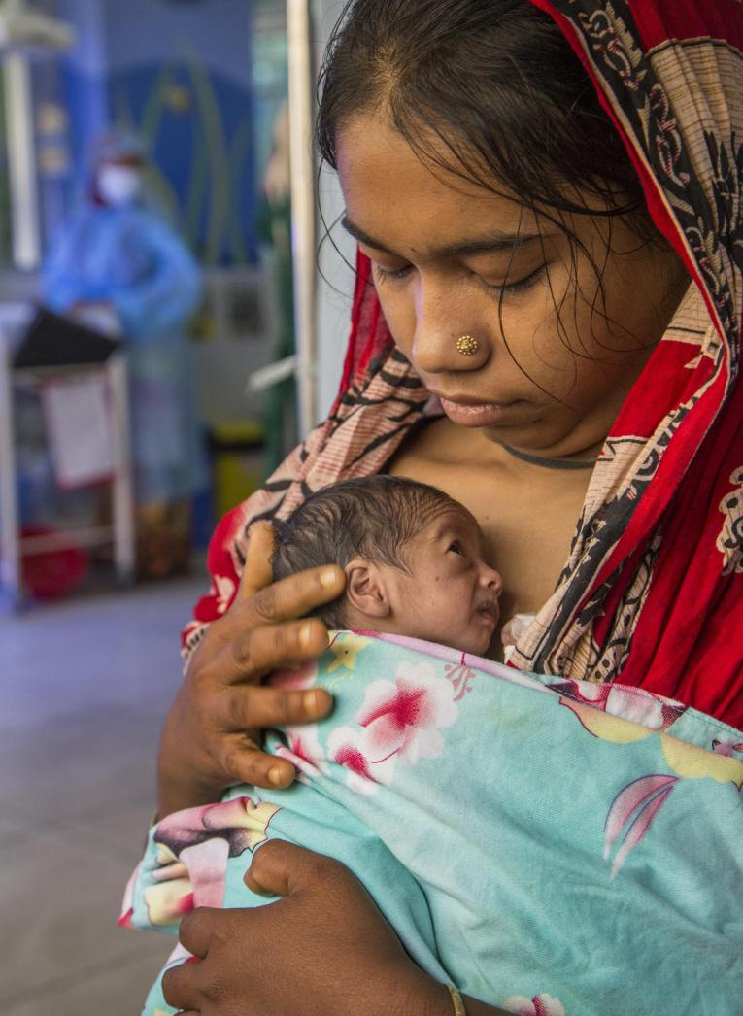
Pregnant women and Children
Issues of concern | How religious leaders/Faith Based organizations can help
Pregnant women susceptibility to Covid-19 Limited access to tailored information Needs to attend medical checkups and services Needs to address fears/anxieties May live with people affected by Covid-19 Underlying health condition | Consult and understand their concerns, fears and needs Support the design and tailoring of messages for children Promote simple practices like hygiene psychosocial issues Provide parents skills to handle and manage children under stress Promote fun activities to reduce anxiety and tension Advocate for counselling support for affected children Consider different needs by gender, context and marginalized group

Slide 6
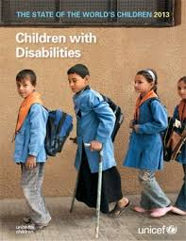
People living with Disabilities
Issue of concern | How religious leaders/Faith Based organizations can help
Barriers to access information and services Often excluded from plans and decision making May be socially isolated | Support active outreach to collect feedback from people with disabilities Support access to information in appropriate and multiple formats Involve them in decision making Provide tailored support to specific needs

Slide 7
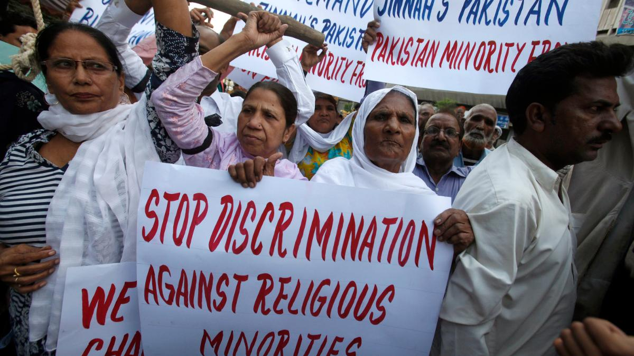
People experiencing discrimination
Issue of concern | How religious leaders/Faith Based organizations can help
Limited or non-access to services Not able to leave and affected area Stigma and discrimination | Translate information to local languages. Listen to questions and concerns in their own language Enable spaces for safe communication for specific vulnerable groups Support minorities to access services and have capacities to cope and adapt

Slide 8
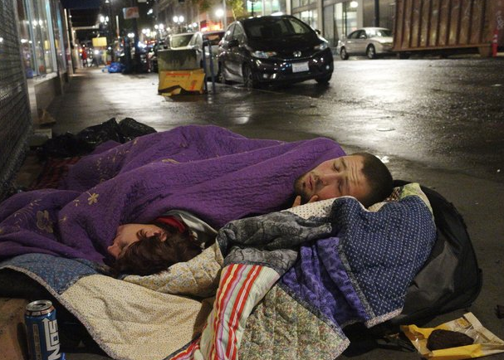
People Experiencing homelessness
Issue of concern | How religious leaders/Faith Based organizations can help
Higher rates of acute primary health needs Prevalent respiratory diseases High exposure to infection and complications More acute risk for the aged | Provide psycho-social support Facilitate shelter reflecting recommended measures Encourage community solidarity Support provision of food, face masks, hygiene basic needs

Slide 9
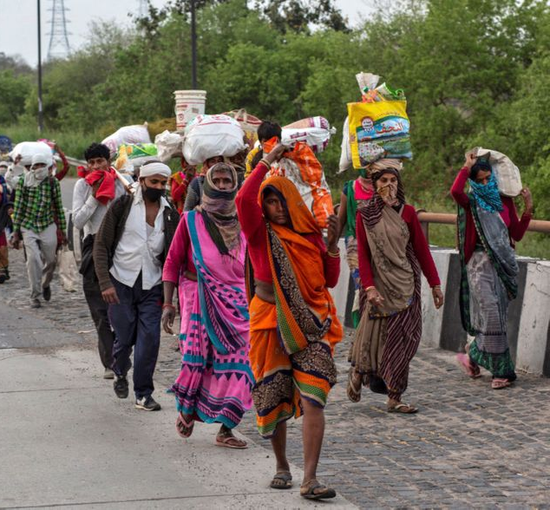
People on the move: migrants, displaced
Issue of concern | How religious leaders/Faith Based organizations can help
Limited access to information, care and services due to legal status, discrimination and language barriers May not be included in response plans Hard to reach for screening due to mobility Lack of documentation Lack of financial resources | Support translation and dissemination of health information Address beliefs, practices and values. Use appropriate channels of communication to reach population of the move. Support services at international borders and transit points Partner with civil society organizations Mobilize volunteers among migrant groups

Slide 10
Risks Faced by Vulnerable Groups
Lack of access to essential services, accurate information and fair treatment
Their needs not included in response plans
Higher risk of dying from the virus than other people
Lack of means for surviving long periods of lockdown, risk of hunger and starvation
Social isolation, lack of safety-net, insurance or healthcare
Population affected by other humanitarian crisis

Slide 11
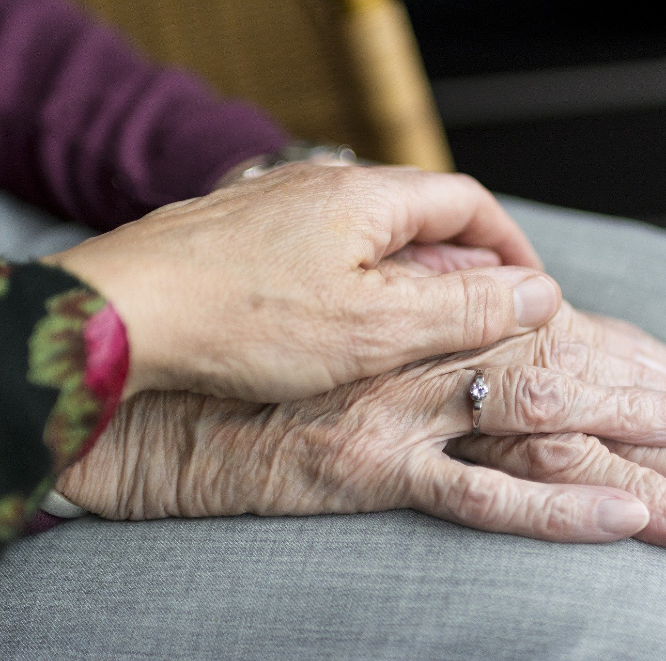
How Faith Leaders Can Help Vulnerable Groups
Identify the most in-risk
Support local authorities to identify vulnerable groups, and assess the faith-community capacity to support.
Adapt to special needs
Understand their needs, listen to their concerns and adapt health messages and formats to their preference.
Approach with care
Approach people living in vulnerable conditions with respect and care, following health regulations like physical distance and using alternatives ways to engage.
Support access to care
Help services reaching vulnerable groups, address special needs, and mobilize community support to mitigate.
Advocate
Facilitate vulnerable and affected people to express their concerns and make them visible through available media channels and digital platforms.
Include
Encourage followers/volunteers to help the vulnerable groups and be empathetic to their needs. Encourage authorities to include vulnerable groups in response plans.
Counter Fear
Address spiritual and mental health, promote positiveness and hope

