Slide 1
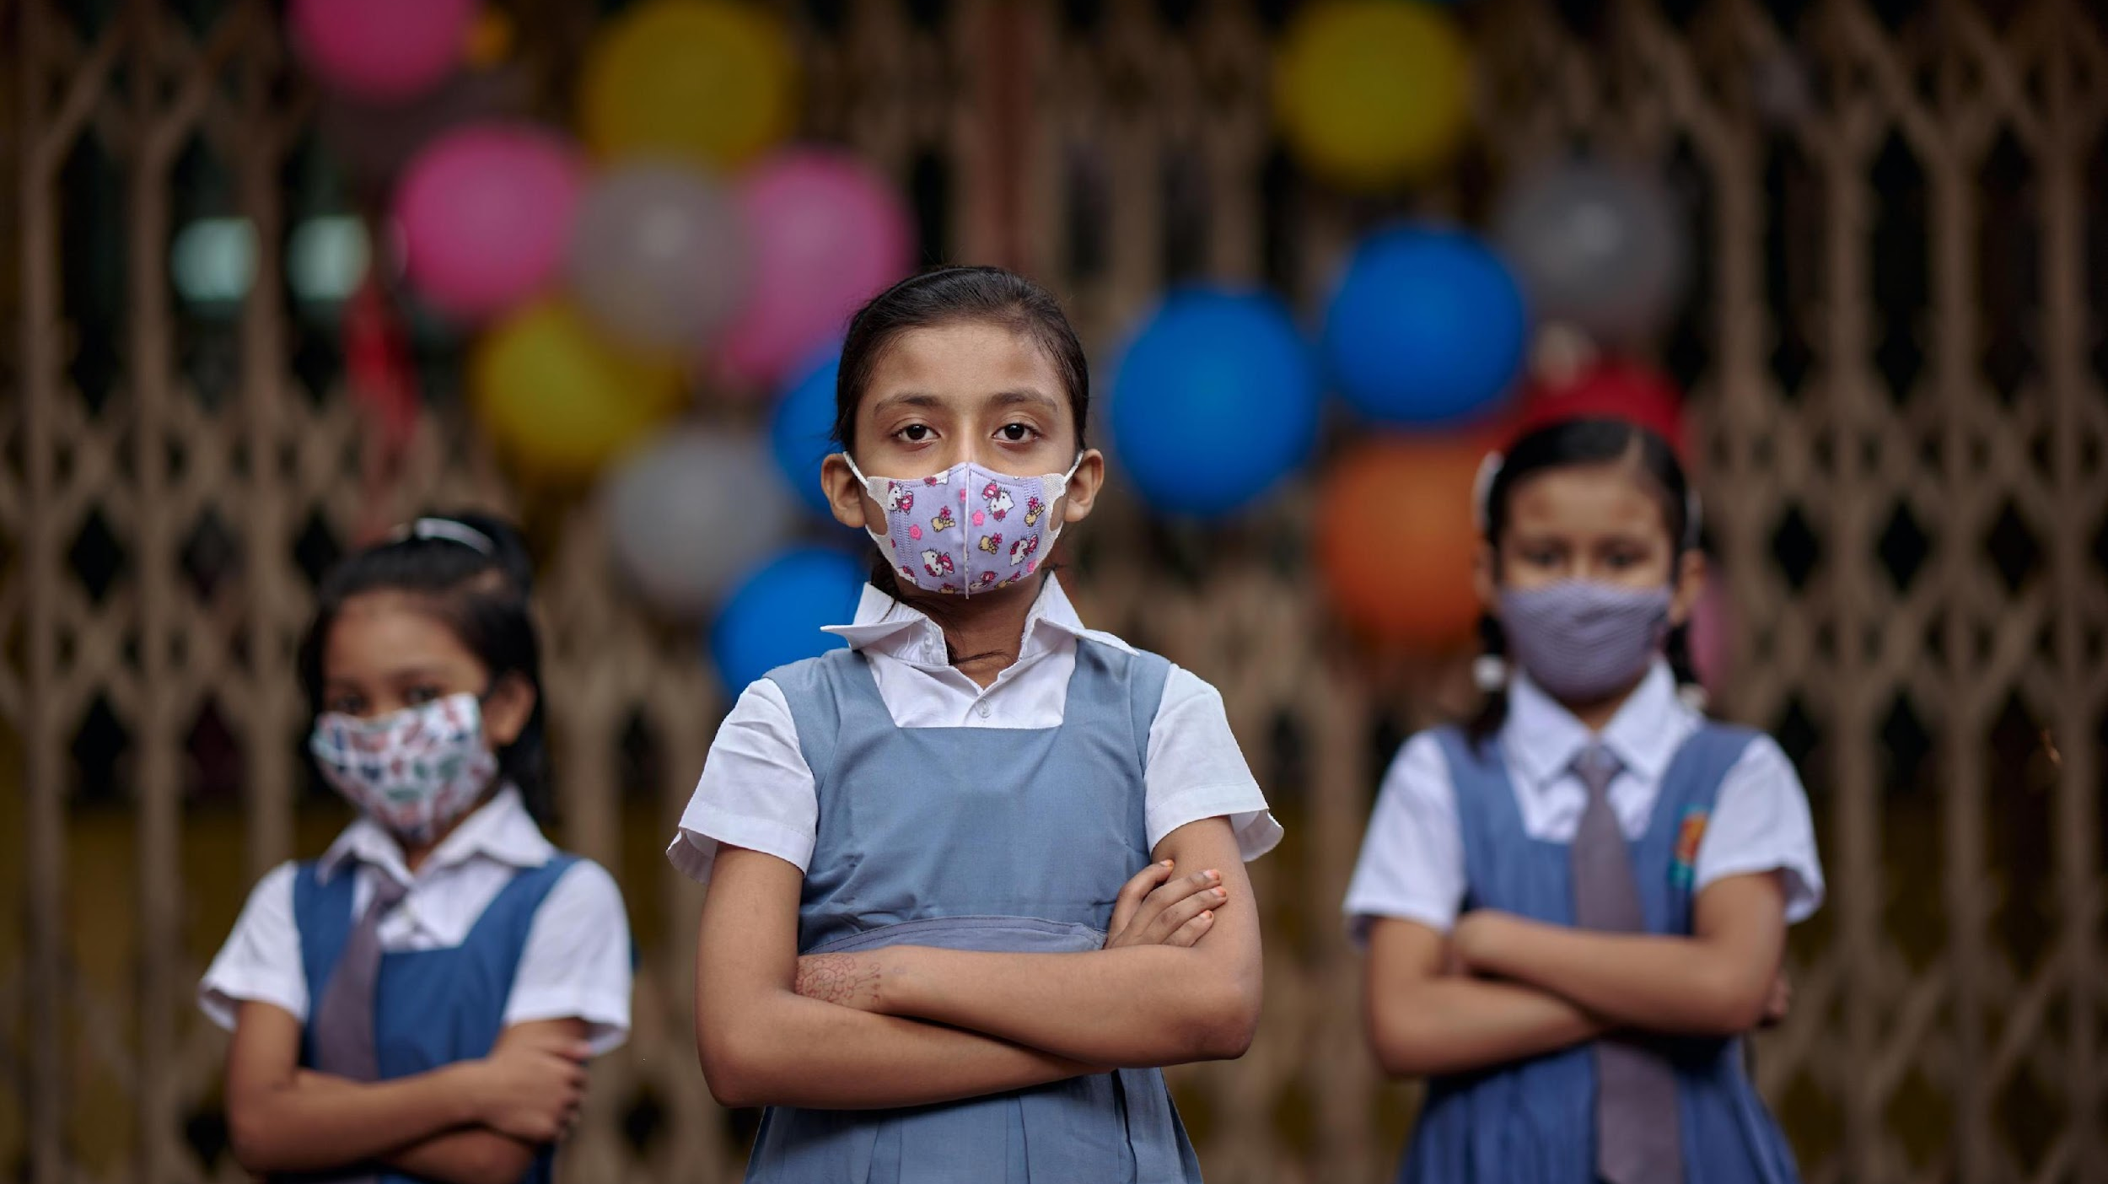
Gender Analytics: Regional Disparities

Slide 2
Drop out from Primary to Secondary Education
Secondary school net attendance drops for majority of the South Asian countries except India for boys and girls
Afghanistan, Bhutan, Bangladesh, Pakistan stark gender disparities
Afghanistan and Pakistan have the lowest overall attendance rates in the region for boys and girls
Source: UNICEF South Asia Pocket Book, 2022

Slide 3
Percentage of youth aged 15-24 years not in education, employment or training
Source: UNICEF Adolescent Data Portal

Slide 4
Child Marriage
Source: UNICEF Adolescent Data Portal

Slide 7
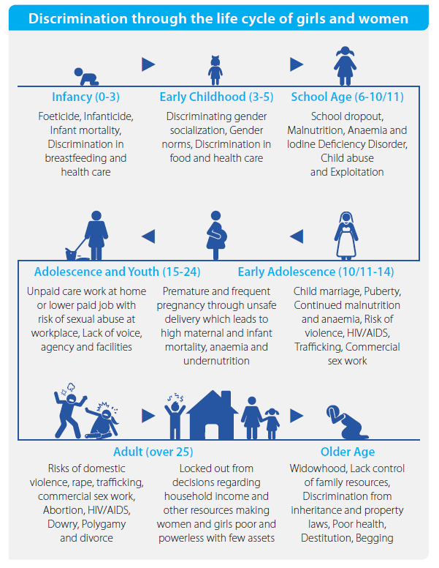

Slide 8
GAP 1: 2014-2017
GAP 2: 2018-2021
GAP 3: 2022-2025
Establish basic gender architecture, define priority results and roll out programmatic models of excellence
Accelerate gender programming, capacity, measurement and resources and showcase established models of programming excellence
Integrate gender equality programming for transformative results in all areas of work across the humanitarian-development nexus and prioritize institutional accountability to reflect gender equality in the UNICEF workplace
Gender Action Plan 2022─2025 Results Framework
Goal Area 1 Health & Nutrition | Goal Area 2 Education | Goal Area 3 Child Protection | Goal Area 4 WASH | Goal Area 5 Social Protection
© UNICEF/UN0430068/Naftalin
Cross-cutting organizational priorities
Address gender-based violence
Gender equality programming for transformative results, including to address discriminatory gender norms
Gender-responsive workplaces and institutional accountability
Quality maternal health care and nutrition, and HIV testing, counselling and care
Gender-responsive education systems and equitable access to education for all
Addressing violence against girls, boys and women and harmful practices
Equitable water sanitation and hygiene systems
Gender-responsive social protection systems and care work
Gender priorities across the life course
Boys and men as allies for gender equality
Promote adolescent girls’ nutrition and pregnancy care, and the prevention of HIV/AIDS and human papillomavirus
Advance girls’ education, learning and skills, including science, technology, engineering, mathematics and digital skills
Eliminate child marriage and early unions
Promote accessible and dignified menstrual health and hygiene services, including tackling taboos about menstruation
Adolescent girls’ leadership and well-being
‹#› | UNICEF Executive Board – Informal briefing –18 August 2021 – Item 5: GAP, 2022–2025

